Slide 1
En Route Automation Modernization (ERAM) North American (NAM) Coordination
ERAM SIG 1814 Change ERAM-CAATS Interfaces from NADIN to Direct TCP/IP
ERAM SIG 1815 Radar Handoffs with NAV Canada
Safety Risk Management Panel
October 2-5, 2018

Slide 2
Agenda
  NAM Coordination Overview
  New Direct IP Interface Infrastructure - SIG1814
  Solution Overview
  AT Changes
  M&C Changes
  Change Summary
  Auto-Handoff Functionality - SIG 1815
  AT Changes

Slide 3
NAM Coordination Overview - Background
NAM Common Coordination (a.k.a. NAM Coordination) introduces capabilities to further automate air traffic control operations between different countries’ air traffic control centers
Initially, NAM Coordination will affect US National Airspace System (NAS) operations only along the northern border with Canada controlled by five US ARTCCs:
  ZSE, ZLC, ZMP, ZOB, & ZBW
  The Canadian ATC system is the Canadian Automated Air Traffic Management System (CAATS)
Current ERAM functionality allows Air Traffic Control (ATC) facilities in both the US and Canada to process messages to exchange flight plan information for flights that transit between the countries
  Messages are routed through the Network Enterprise Management Centers (NEMC) at Salt Lake City and Atlanta and the FAA Telecommunications Infrastructure (FTI), using National Airspace Data Interchange Network (NADIN)
ERAM current design does not provide an automated means for any US ATC facility to handoff flights to or accept handoffs from any Canadian ATC facility
  Handoffs use workload intensive manual methods, phone calls required

Slide 4
NAM Coordination Overview
NAM Coordination is an ERAM enhancement in the “ERAM Enhancements 2” (EE2) package
  The introduction of automated handoff capability between the countries will increase the safety and efficiency of the NAS
The NAM Coordination Enhancement is divided into two Software Releases
  New Direct IP Interface Infrastructure: NAM Coordination replaces the NADIN-based interface (I/F) between adjacent NAM ATC centers with a direct TCP/IP connection interface (“NAM Direct IP”) (SIG 1814)
    Existing ATC messages exchanged between ERAM and neighboring Area Control Centers (ACCs) are migrated from NADIN to a NAM Direct IP interface between adjacent center pairs
    This release establishes NAM Direct IP between ERAM and CAATS at adjacent facilities
    M&C Changes for NAM Direct IP are covered in this release
  Auto-Handoff Functionality: NAM Coordination introduces the exchange of new ATC messages via NAM Direct IP for automated radar handoff (SIG 1815)
NAM Direct IP and migration of existing messages (SIG 1814) targeted for deployment ~2020
New automated handoff messages (SIG 1815) targeted for deployment ~2021

Slide 5
NAM Coordination Overview (continued)
NAM Direct IP infrastructure replacing use of NADIN
  Eliminates dependency on an intermediary messaging system
  Enables end-to-end interface statusing and control currently masked by NADIN
  Eliminates constraints currently/potentially imposed by NADIN
  Replacing store and forward infrastructure with direct TCP/IP connection supports delivery of time critical data, e.g., track update messages for automated handoff and eventually Point Out messages (future)
  Leverages strategic, common infrastructure for IP-based I/Fs to external systems and for NAS perimeter security FTI (NAS Enterprise Security Gateway (NESG)
NADIN will remain available:
  Between ERAM and CAATS for transition and tie-off purposes
  For Non-US Auto I/Fs not yet transitioning to NAM Direct IP
  For Service B-User and Non-US Manual I/Fs (no change for these I/Fs)

Slide 6
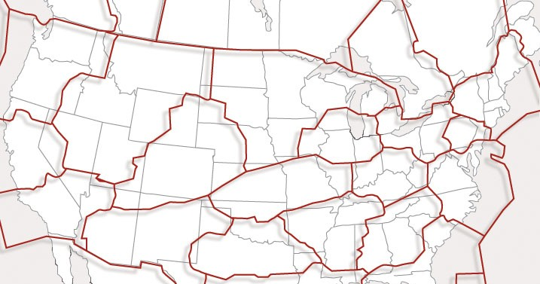
NAM Coordination Overview (continued)
Adjacent Facility Pairs¹ Covered by EE2
Vancouver
CZVR
Edmonton
CZEG
Winnipeg³
CZWG
Moncton
CZQM
Toronto
CZYZ
Montreal³
CZUL
ZSE
ZLC²
ZMP
ZBW
ZOB
ZTL²
1) Additional test system connectivity is also needed between the William J. Hughes Technical Center (WJHTC) and the NAV CANADA Technical Systems Centre (NCTSC) in Ottawa
2) CAATS interfaces with all ERAM ARTCCs via the NESGs adjacent to ERAM national sites (ZLC, ZTL)
3) ERAM interfaces with CAATS ACCs via the Winnipeg and Montreal gateways

Slide 7
NAM Direct IP Solution Overview (SIG 1814)
Technical Discussion

Slide 8
SIG 1814 – NAM Direct IP Solution Overview
Being a NAS-external TCP/IP connection, the NAM Direct IP design is required to use the US security gateways for IP interfaces, i.e., the NESGs
FTI provides the networks to the US NESGs
  Between the NESGs and the Canadian gateways to their ATC systems (CAATS)
  Between the NESGs and ERAM
  Between the two NESGs (when ERAM is accessed via the other NESG at the backup ERAM National Site)
Using the NESG requires a new “interface proxy application” in the NESG to validate messages from external systems and to proxy ERAM’s interface for security purposes
  The TCP/IP connection from a Non-US systems must “terminate” at the proxy
  Separate, “connections” to internal systems (ERAMs bordering Canada) are proxied and protected
The new application (“NAM I/F Proxy” a.k.a. “IA3”) will run on the PGW FEP, the front end processor currently in the NESG for Data Comm
  The NAM I/F Proxy is a new ERAM National Application (NAP) Realm application
The PGW FEP will be upgraded with a new LAN adapter to provide two new LAN ports dedicated to NAM Direct IP
  Gives NAM Direct IP its own networks to separate NAM Coordination messaging from Data Comm messaging, as required for security

Slide 9
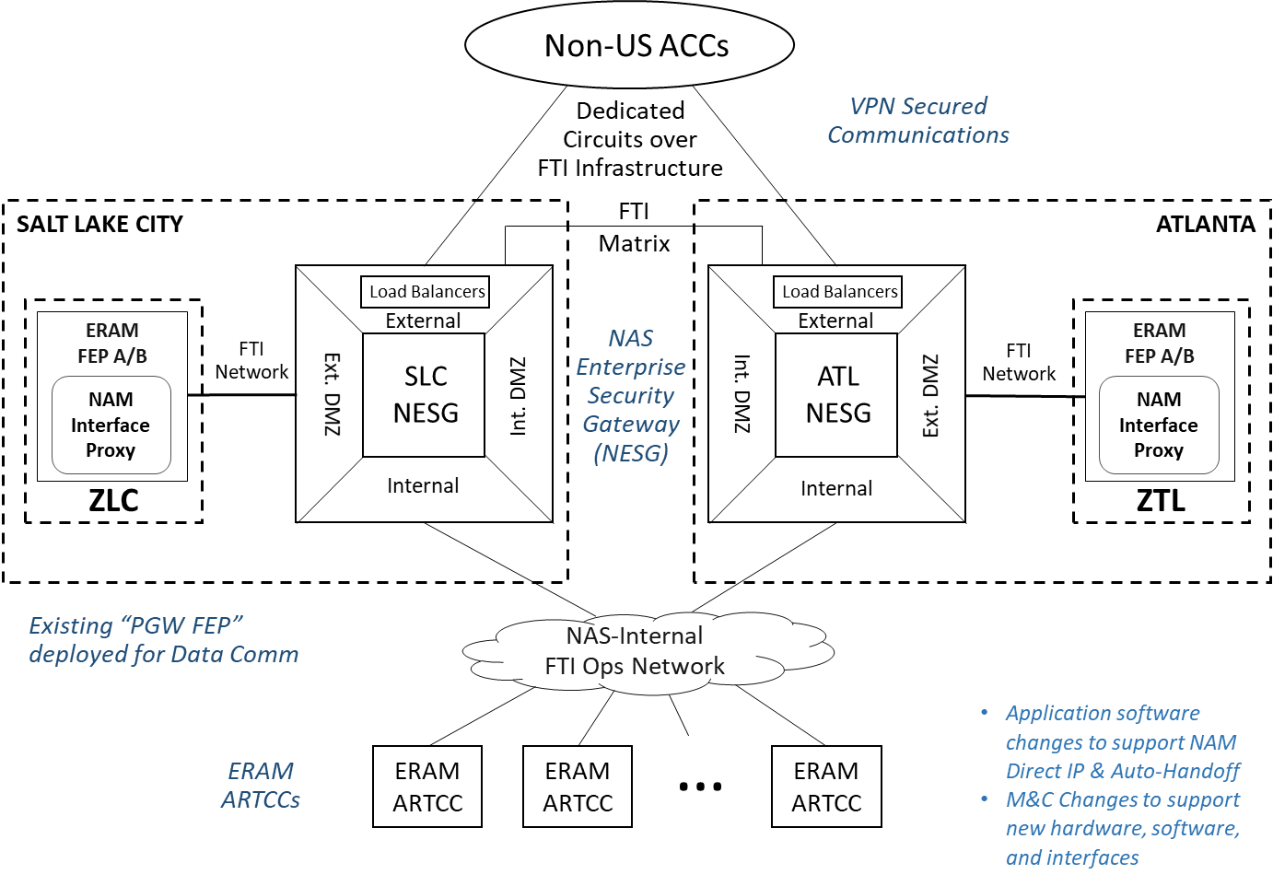
SIG 1814 – NAM Direct IP Solution Overview (cont.)

Slide 10
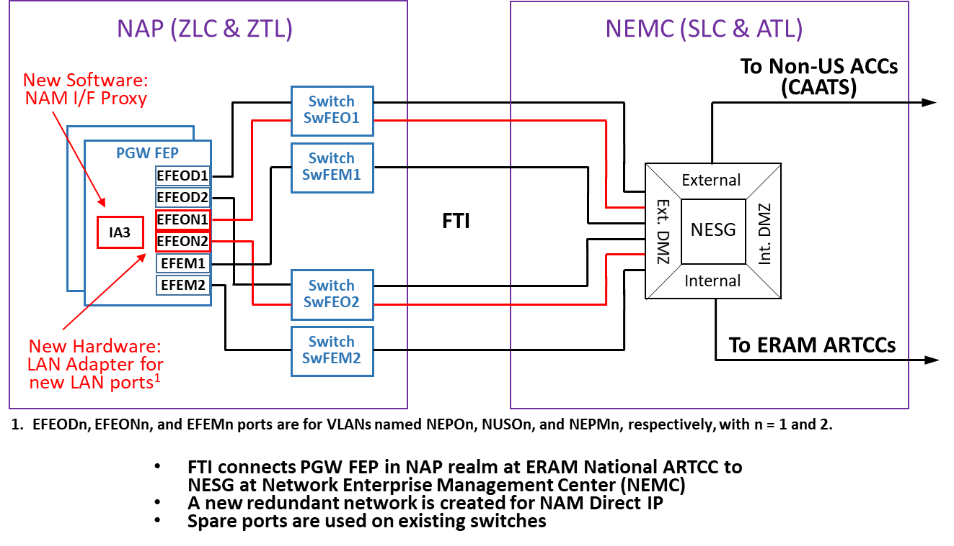
SIG 1814 – NAM Direct IP Solution Overview

Slide 11
SIG 1814 – NAM Direct IP Solution Overview (cont.)
There are eleven ARTCC - Non-US ACC I/Fs, one per adjacent center pair (e.g., Seattle & Vancouver is one pair, Seattle & Edmonton is another pair)
  New facility adaptation identifies neighboring ACC(s) as NAM Direct IP-capable
An I/F is either “initialized” or “terminated.” An I/F must be “initialized” before ATC messages can be exchanged between adjacent centers.
An initialized I/F requires the following:
  An external “connection” between the Non-US ACC system (CAATS) and the NAM I/F Proxy on the PGW FEP. This is a TCP/IP connection.
  An internal “connection” between the NAM I/F Proxy and ERAM at the ARTCC adjacent to the Non-US ACC. This is an ERAM middleware connection (via FlightDeck, a.k.a., FDK) with the IA2 application on the FDPP in ERAM’s Channel Realm.
  An I/F initialization handshake between ERAM (IA2) and the adjacent Non-US ACC using new “interface management” messages exchanged over the connections
    IRQ, IRS (interface initialization request and response)
    TRQ, TRS (interface termination and response)
    ASM, LAM (status message and response)

Slide 12
SIG 1814 – NAM Direct IP Solution Overview (cont.)
The Non-US ACC requests the external connection to ERAM, and ERAM (NAM I/F Proxy) accepts if that connection I/F is “enabled” (via M&C NAP Subsystem Window at the active ERAM National Site)
  ERAM establishes internal connections (FDK “national partnerships”) between ARTCCs and the NAM I/F Proxy if those connections are enabled at both the ARTCC and national site
Both the ARTCC and its adjacent non-US ACC must “enable” the I/F in order to initialize their I/F with each other (using established connections). This is done via the M&C CHI External Interfaces window for ERAM at the ARTCC.
  The ARTCC – Non-US ACC interface is referred to as a “session interface” to distinguish it from the underlying connections used
Disabling the I/F triggers exchanging the “interface management” messages to “terminate” the I/F

Slide 13
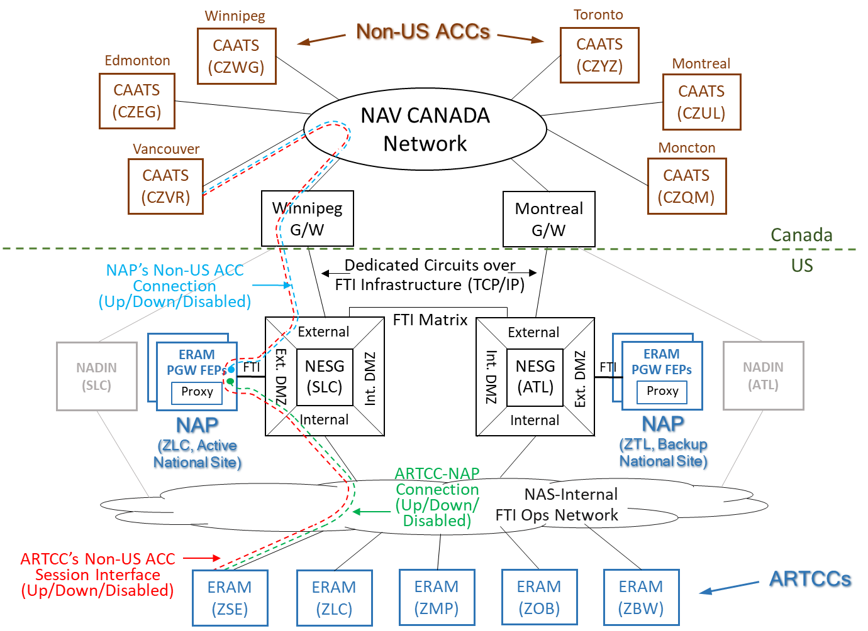
SIG 1814 – NAM Direct IP Solution Overview (cont.)

Slide 14
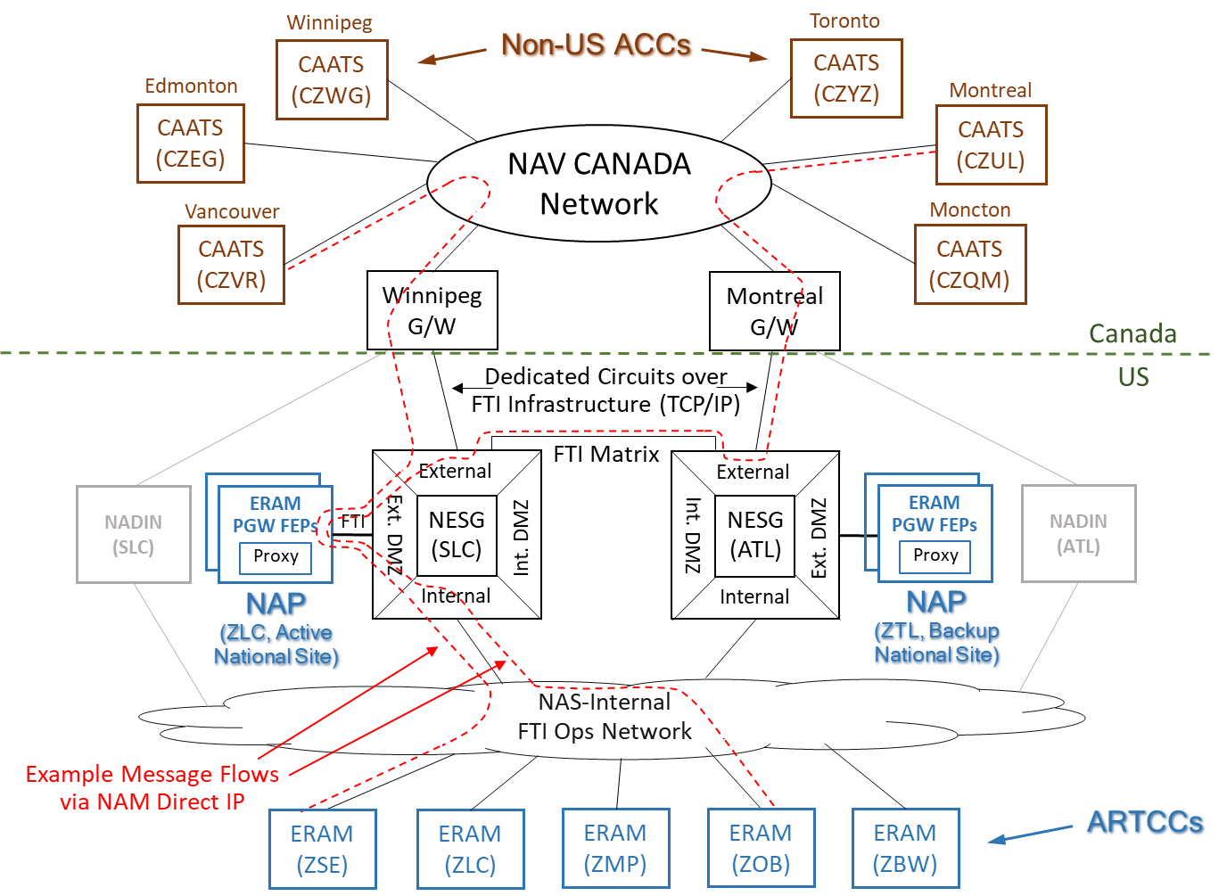
SIG 1814 – NAM Direct IP Solution Overview (cont.)

Slide 15
SIG 1814 – NAM Direct IP Solution Overview
To support transition and tie-off, adjacent centers can still use NADIN instead of NAM Direct IP for their I/F
To switch from one to the other, the other must first be disabled, e.g., NAM Direct IP cannot be enabled for Seattle-Vancouver until NADIN is first disabled for Seattle-Vancouver
ERAM’s External Interfaces Window is used to control NADIN and Non-US ACC interfaces
  Existing NADIN group box for I/Fs via NADIN
  New Non-US ACC group box for I/Fs via NAM Direct IP
ERAM’s NAP Subsystem window provides status and control of NAP Realm connections with Non-US ACCs and ARTCCs, i.e.,
  The eleven connections the NAM I/F Proxy has with CAATS, one for each adjacent center pair (Up/Down/Disabled)
  The five connections the NAM I/F Proxy has to ERAM, one for each ARTCC bordering Canada (Up/Down/Disabled)
Connections between the NAM I/F Proxy (in the NAP Realm) and ERAM at a border ARTCC (in the Channel Realm) are possible only when both realms are in active mode or both are in the test mode

Slide 16
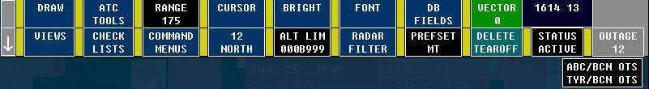
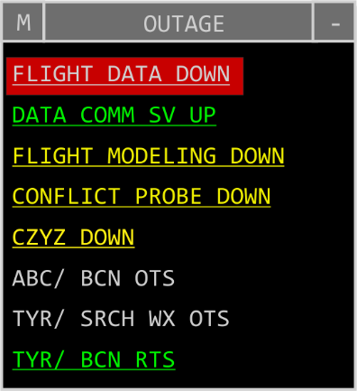
SIG 1814 – NAM Direct IP Solution AT CHI Changes
  D-position Outage View and R-position Outage List and Status View are changed to display status of new ERAM-to-CAATS external interfaces (one for each neighboring CAATS)
R-Pos
D-Pos

Slide 17
SIG 1814 – NAM Direct IP Solution M&C CHI Changes
National ARTCCs (ZLC & ZTL)
  NAP Subsystem window changes
  Two new Interface Details windows
  PGW FEP Processor Status window changes
  SwFEO LAN Switch Location & Connectivity Report
Canadian Border ARTCCs
  External Interfaces window changes

Slide 18
SIG 1814 – National ARTCCs Changes
NAP Subsystem Window
Current
With SIG1814
All changes are
in the External I/Fs
group box.
- Creating 2 internal group boxes to
distinguish functions
- MCI in its own group box because it services
both Data Comm and
Non-US ACC for
monitor & control info, and it is located under the DC Status icon’s
group box so that it won’t have to move again.
- Details of Non-US ACC group box contents are on the next page.

Slide 19
SIG 1814 – National ARTCCs Changes
NAP Subsystem Window
With SIG1814
  Non-US ACC group box contents:
  NUSAC (Non-US ACC Interfaces – Channel) icon
    Roll-up of connection interface statuses between the NAP realm and the ARTCCs bordering Canada that communicate with the CAATS ACCs (Area Control Centers) for Non-US Automated messaging
    Up/Degraded/Down/Disabled
    Connections are IA2-IA3 FDK partnerships.
    Is extensible to non-CAATS ACCs.
    Double clicking on the NUSAC icon displays the Non-US ACC: Channel Interface Details window (on next page)
  ACC icon
    Roll-up of connection interface statuses/states between the NAP I/F Proxy and the CAATS ACCs
    Up/Degraded/Down/Disabled
    Named “ACC” because is extensible to addition of future non-CAATS ACCs.
    Double clicking on the ACC icon displays the Non-US ACC: ACC Interface Details window (2 pages hence)

Slide 20
SIG 1814 – National ARTCCs Changes
Two New Interface Details Windows
1. Non-US ACC: Channel (NUSAC) Interface Details window
Provides IA3-to-IA2 connection status – where IA3 is on the PGW FEPs and IA2 is on each ARTCC’s Active channel
Contents are the ARTCCs with non-US Auto communications with CAATS ACCs
Status: Up/Down/Disabled
With SIG1814
Event associated with this Down ZSE interface:
  Type: Warning
  Subject: Interface
  Resource: NUSAC
  Component: ZSE
  Message: NAP: External interface is DOWN
Note: As shown in this example with instances of Up, Down, and Disabled, the NUSAC icon on the NAP Subsystem window would be degraded.

Slide 21
SIG 1814 – National ARTCCs Changes
Two New Interface Details Windows
With SIG1814
2. Non-US ACC: ACC Interface Details window
Provides connection state/status between IA3 on the PGW FEPs and each Canadian ACC, one for each ARTCC/ACC pair.
There are 11, not 6, interfaces because CAATS is responsible for requesting the TCP/IP connection for each designated neighbor.
State/Status: Up/Down/Disabled
Can Enable or Disable any pair.
Deliberately leaving out repetitive ARTCC names to facilitate reading.
Event associated with this Down CZUL interface:
  Type: Warning
  Subject: Interface
  Resource: Non-US ACC: ACC
  Component: CZUL for ZBW
  Message: NAP: External interface is DOWN
Note: As shown in this example with instances of Up, Down, and Disabled, the ACC icon on the NAP Subsystem window would be degraded.

Slide 22
SIG 1814 – National ARTCC Changes
PGW FEP Processor Status Window Changes
Prior to SIG1814 (EAE200)
With SIG1814
Details on the next page

Slide 23
SIG 1814 – National ARTCC Changes
PGW FEP Processor Status Window Changes, continued
Hardware
Add two new internal group boxes: “Data Comm” and “Non-US ACC”
Add two new LAN ports that connect to the existing SwFEO switches (Front End Operational LAN switches) for the Non-US Auto communications (NAM I/F Proxy data).
The labels on all four ports are updated to reflect their functionality:
  “EFEOD” 1 & 2 (Ethernet port for frontend operational Data Comm LAN connection)
New labels for the Non-US ACC operational ports:
  “EFEON” 1 & 2 (Ethernet port for FrontEnd Operational Non-US ACC connection)
Software
Add two new internal group boxes: “Data Comm” and “Non-US ACC”
Add IA3 OU (new NAM I/F Proxy) to communicate with IA2 at the ARTCCs and with the Non-US Auto ACCs.
Note: Imbedded group boxes were introduced with EAE200 via SIG 1795 “M&C CHI Updates to ERAM SIG 1704 – TR2 Full ERAM Software Changes”.

Slide 24
SIG 1814 – National ARTCC Changes
PGW FEP Processor Status Window, continued
With SIG1814
Collateral effects of OU failure):
  If IA3 OU is down, all of the Non-US Auto Channel interfaces and Non-US Auto ACC interfaces will also be down.
  If DMI OU is down on ops channel, there is no operational impact. DMI is only used for injecting simulated DCNS, TIMS, and Non-US ACC inputs. If a simulation was in progress with PGW Emulation Off, the MCP with the SSRV PAS displays degraded along with a degraded SSRV.
  If MCEF OU is down, the NEPO and NEPM switches will be marked down (even though they may not be down) in the NAP Subsystem window.
  If PFF is down, DC Logon Corr service is down, TIMS and DCNS interfaces are down, and all enabled DLCC interfaces are down.

Slide 25
SIG 1814 – National ARTCC Changes
NAP Subsystem’s SwFEO LAN Switch L&C Report
Currently
With SIG1814

Slide 26
SIG 1814 – National ARTCC Changes
NAP Subsystem’s SwFEO LAN Switch L&C Report, continued
With SIG1814
A NUSO (Non-US Operational) VLAN is added to each SwFEO LAN switch
Labeling of the ports identifies the type of operational data
The ports on the new NUSO VLAN are:
  FTIN (port 1)
  FEP1N (port 3)
  FEP2N (port 5)
The existing Data Comm VLAN port labels are updated to:
  FTID (port 10)
  FEP1D (GigE port A)
  FEP2D (GigD port B)
A footnote is added to identify the meaning of the port labels.

Slide 27
SIG 1814 – National ARTCC Changes
NAP Subsystem Window File Drop-Down Menu
Currently
pre-SIG1814
With SIG1814

Slide 28
SIG 1814 – National ARTCC Changes
NAP Subsystem Window
Right Click Menu
Currently
pre-SIG1814
With SIG1814

Slide 29
SIG 1814 – Canadian Border ARTCC Changes
External Interfaces Window (ZLC example)
Current
(Assumes SIG 1779 RUC > RAP)
With SIG1814
Add
Non-US
ACC
group
box

Slide 30
SIG 1814 – Canadian Border ARTCC Changes
External Interfaces Window (ZLC example)
NADIN group box:
Software will automatically add “X”prefix to the NADIN CAATS interfaces so that they are distinguishable from the NAM Direct IP I/F counterparts. (Rationale is to add letter to the interface name that is ultimately going away after transition.)
New “Non-US ACC” group box (below the NADIN group box)
  NUSAN (Non-US ACC – NAP) Icon:
    To status ARTCC’s internal connectivity with NAP realm for the purpose of communicating with the adjacent non-US ACCs.
    Up/Down/Disabled
    Enabling triggers IA2 to establish connection with IA3
    Disabling triggers IA2 to discontinue connection with IA3.
  ACC (CAATS) Icons:
    Channel-to-<neighbor ACC > interface control and status
    Up/Down/Disabled
    Each interface is via the new NAM Direct IP I/F.
    Enabling triggers the interface management message exchange with a neighboring ACC to initialize the ERAM-ACC interface for ATC messaging.
    Disabling triggers the interface management message exchange to terminate the interface.
Enabling a NAM Direct IP I/F icon for an ACC I/F is prohibited until the NADIN icon for that ACC I/F is disabled – and vice versa.
Events (M&C alerts) for NAM Direct IP interfaces will be similar to existing ones for other interfaces. (Name will distinguish NAM Direct IP I/F from NADIN I/F.)
With SIG1814

Slide 31
SIG 1814 – Canadian Border ARTCC Changes
External Interfaces Window (ZLC example)
Results of enabling/disabling the Non-US ACC interfaces
If the Active NAP realm disables the connection to an ACC for a particular border ARTCC, the ARTCC will see that ACC interface go down (if enabled) due to message timeouts.
If the Active NAP realm disables the connection to a border ARTCC, the ARTCC will see all enabled interfaces in the Non-US ACC group box go down (NUSAN interface and ACC interfaces).
If a border ARTCC disables the NUSAN interface, then all of its enabled ACC interfaces will go down, and the Active NAP realm will see its NUSAC roll-up icon go degraded.
If a border ARTCC disables an ACC interface, the Active NAP realm should not see any change, because its interfaces to border ARTCCs and to the ACC are connection statuses, not interface statuses.
Default Commanded States of NUSAN and Non-US ACC interfaces
After a cold start, a channel becomes Pending and all interfaces are disabled, including NUSAN and non-US ACC interfaces.
Upon promoting a Pending channel to Backup, the NUSAN and Non-US ACC interfaces remain disabled, but acquire from channel sync the commanded states from the Active channel so these states are retained when the Backup channel is promoted to Active.
If the Pending channel is commanded directly to Active mode (an exception activity), then:
  NUSAN interface is enabled only if there is at least one direct IP capable non-US ACC neighbor.
  Each non-US auto ACC interface is enabled for direct IP if it is direct IP capable. If it is not direct IP capable, then it is enabled for NADIN.
With SIG1814

Slide 32
SIG 1814 – NAM Direct IP Solution System/Service Certification
At All Border ARTCCS:
The FAA may use any of the following as part of certifying the new NAM Direct IP interface:
  The Up/Down/Disabled status of the NAM Direct IP interface with each neighbor
    Status will remain Up for enabled I/Fs only if messages are being received. ASM messages are sent to solicit response when no ATC messages are being received.
  A CPL for a test flight (a flight with an aircraft identifier beginning with “TTT”) can be sent to CAATS to solicit a LAM response from CAATS, and should be followed by the sending of a CNL message for that flight to delete the test flight plan from CAATS. A LAM for the CNL is also expected.

Slide 33
SIG 1814 – NAM Direct IP Solution Change Summary
At National Sites (ZLC and ZTL):
New hardware: PGW FEP LAN adapter & two cables to SwFEO switches
New software: NAM I/F Proxy (IA3) on the PGW FEPs
Distribution and Cutover: Add IA3 to PGW FEP release map
  No impact to Backup/Restore
M&C CHI
  NAP Subsystem Window
    New “ACC” and “ARTCC” icons
  Processor Status Window for PGW FEP
    New LAN port hardware connections and software application (IA3) for NAM I/F Proxy
  SwFEO LAN Switch Location & Connectivity Report
    Spare ports now used for the new NAM Direct IP LANs
At All Border ARTCCS:
AT CHI gives status of new external I/Fs
No new hardware or software on ERAM Channels
M&C CHI
  External Interfaces Window
    New “Non-US ACC” group box with new “NUSAN” and ACC (CAATS) icons

Slide 34
Automated Radar Handoffs for NAV Canada
Capability Overview (SIG 1815)
Technical Discussion

Slide 35
SIG 1815 – Automated Radar Handoffs for NAV Canada Overview
SIG1815 is adding an automated handoff capability that will be used between ERAM ARTCCs and CAATS ACCs
  At a high level, the automated handoff capability between ERAM and CAATS is based on a subset of existing ERAM-to-ERAM handoff capabilities
New messages (Class 3) are being added to support automated handoff with CAATS via the new NAM Direct TCP/IP interface
  The exchange of Class 3 Messages between ERAM and an adjacent Non-US ACC system is defined in the NAM ICD, Version E dated April 2016

Slide 36
SIG 1815 – Auto Handoff Operations
Operational Provisions:
Handoff is only supported for flights that are exiting to or entering from CAATS airspace.
  Side stream handoffs (SSHO) for flights with routes that do not cross the U.S./Canadian border are not allowed.
Non-radar handoffs are not supported.
  A flight must be paired to a track with an established beacon code as a prerequisite for handoff initiation.
    However, if a radar handoff is received from CAATS and ERAM is not tracking the aircraft the handoff is still accepted and DATA is displayed in the FDB per the existing ERAM to ERAM (E2E) handoff functionality.
    After the ERAM handoff recipient sector accepts the DATA handoff a QT command must be entered (radar identification) before a subsequent handoff can be initiated (existing behavior).
  Handoff of flights that are paired to a primary track are not allowed (QN command is rejected).
  CAATS will not accept a handoff message from ERAM that includes a track established code that does not match the CAATS assigned code.
Auto Handoff is not allowed for VFR flights.
  The NAM ICD does not support the transmission of VFR flight plans with Non-US centers.
The existing automatic handoff initiation function is not modified other than to now consider a predicted outbound crossing from the local ERAM into a CAATS facility as a trigger for automatic handoff initiation.

Slide 37
SIG 1815 – Auto Handoff CAATS Sector ID
CAATS sector ID format.
  Per the NAM ICD, the format of a Non-US facility sector ID is defined using two alphanumeric characters
    The syntax for a CAATS sector ID is 2 alphabetic characters.
  ERAM currently supports:
    A three digit ID (however, in practice only 2 digits are utilized) and
    A digit/alphanumeric ID (ARTS position).
  The ERAM operator command syntax, inter-facility message syntax, underlying flight data structure and functions that depend on the flight data structure must be updated to accommodate the CAATS format.

Slide 38
SIG 1815 – Auto Handoff Command Entry
In general most of the existing command and message validation for handoff carries over to handoffs involving CAATS facilities
QN/QZ Command – Initiate handoff
  The command currently supports the entry of a recipient facility and sector (directed handoff) or just a recipient facility identifier (undirected handoff).
  For a directed handoff, the command validation and acceptance processing is updated to accommodate the new two character alphabetic CAATS sector ID.
    The Non-US facility adaptation is also updated to include a single character facility ID for each CAATS border facility.
    The single character may be used in the QN command to identify the neighbor CAATS facility.
QN/QZ Command – Accept Handoff
  Used to both accept an inbound handoff and retract an outbound handoff.
  No changes required for SIG1815 – the command does not support or need the entry of a CAATS sector ID since there can only be one handoff in progress for a given flight.

Slide 39
SIG 1815 – Auto Handoff Command Entry (cont.)
QA Command – Select Automatic Handoff
  No syntax changes. However, new validation is required to ensure that an identified CAATS facility is currently handoff enabled as a prerequisite to allowing automatic handoff initiation.
CP & EP - Change Parameter and Examine Parameter Commands
  Updated to accommodate the management of a new dynamic parameter for enabling/disabling automated handoff with a particular CAATS facility (i.e., a transition switch).
  New validation is required to ensure that an identified CAATS facility is currently handoff enabled as a prerequisite to enabling automated handoff.
Procedural Handoff is supported per existing capabilities
  E.g., QX (Drop Track) or QX /R (Surrender Control) commands may be used for flights outbound to CAATS
  A Start Track (QT) or Steal Control (QT *) may be used for flights inbound from CAATS

Slide 40
SIG 1815 – Auto Handoff Display
The existing Field E handoff display items are reused for handoffs with CAATS:
  Handoff status qualifier (H, O, K).
  OLD: indicates track update data from CAATS (RTU message) is not being received in a timely manner during handoff.
  FAIL: indicates a handoff initiate message (RTI) or handoff accept message (RTA) has been rejected.
  DATA: Displayed during a handoff where the local ERAM is not tracking the flight.
  MISM: Displayed during handoff when the track data received in an RTU from the handoff originator does not match the local track data.

Slide 41
SIG 1815 – Auto Handoff Display (continued)
The single-letter CAATS facility ID and the two-letter CAATS sector ID will appear in the following lists and displays:
List/View | R-Position | D-Position
Auto Handoff Inhibit List | Yes | No
Continuous Flight Plan Readout (CRF) View | Yes | No
Conflict Alert View | Yes | No
Hold View | Yes | No
Aircraft List | No | Yes
Plans Display | No | Yes
Message Out | Yes | Yes
Message History | Yes | Yes
Aircraft List entry example:
Flight controlled by CAATS facility “L” sector “ND”

Slide 42
SIG 1815 – Auto Handoff Messages
Four New Auto Handoff Related Messages are exchanged between ERAM and CAATS:
  RTI: Radar Transfer Initiate
    The existing Logical Reject Message (LRM) is used for RTI rejection.
  RLA: Radar Handoff Logical Accept
    System generated acceptance response to a received RTI.
  RTU: Radar Track Update
    Adapted off for ERAM to CAATS during handoff. CAATS currently does not receive track updates during inter-facility handoff.
  RTA: Radar Transfer Accept
    Controller generated handoff acceptance message.
    The existing Logical Accept Message (LAM) is used for RTA acceptance.
    The existing Logical Reject Message (LRM) is used for RTA rejection.

Slide 43
SIG 1815 – Auto Handoff Sequence Diagrams 1 of 4
Sequence diagrams – ERAM Initiate Handoff to CAATS

Slide 44
SIG 1815 – Auto Handoff Sequence Diagrams 2 of 4
Sequence Diagrams – CAATS Handoff Acceptance

Slide 45
SIG 1815 – Auto Handoff Sequence Diagrams 3 of 4
Sequence Diagrams – CAATS Initiate Handoff to ERAM

Slide 46
SIG 1815 – Auto Handoff Sequence Diagrams 4 of 4
Sequence diagrams – ERAM Handoff Acceptance

Slide 47
SIG 1815 – Auto Handoff, HNH Handoff
Host non-Host (HNH) handoffs are not supported.
A Canadian terminal facility is configured as a local sector in the CAATS system. In addition, a CAATS sector ID is comprised of two alphabetic characters.
This format however, is not supported by the local ARTS interface and the ARTS interface is not being updated to support automated handoff with CAATS. Therefore, there is no automated handoff support between ARTS and CAATS.
CAATS terminal position is fully integrated into the CAATS ACC environment, therefore, an ERAM sector and a CAATS terminal will be able to directly handoff to each other since at the automation level there is no difference between a CAATS enroute sector and a terminal position
HNH Scenario Examples
ERAM
CAATS
 | Automated Handoff Scenarios | SIG1815 Behavior
1 | ERAM Sector to CAATS Sector | Supported
2 | ERAM Sector to CAATS Terminal | Supported
3 | Local ARTS to CAATS Sector | Not Supported
4 | Local ARTS to CAATS Terminal | Not Supported
5 | CAATS Sector to ERAM Sector | Supported
6 | CAATS Sector to ARTS | Not Supported
7 | CAATS Terminal to ERAM Sector | Supported
8 | CAATS Terminal to ARTS | Not Supported
Q
ARTS
Q
Q
Q

Slide 48
SIG 1815 – Auto Handoff Tracking
In general, SIG1815 is not making any modifications to the tracking behavior performed when a handoff related message is received by the local ERAM. For example:
  If the track data in a handoff message (e.g., RTI) does not match the track data of the local track that is paired to the flight then the RTI is rejected.
    Differences in track location, speed, heading, altitude and established beacon code are analyzed.
  If the track data in a track update message (e.g., RTU) received during handoff does not match the track data of the local track that is paired to the flight then “MISM” is displayed in Field E of the FDB indicating a radar identification mis-match between CAATS and ERAM.
The only exception is that SIG1815 is adding new adaptation to support alternate distance and altitude tolerance values that will be applied to handoff messages received from CAATS facilities.
  However, the nominal values for the new tolerances will be initially set to the existing track match tolerances and only modified if problems arise during, for example, testing or field operations.

Slide 49
SIG 1815 – Auto Handoff Auto Control Assignment
After automated handoff is enabled with a CAATS facility, the auto assignment of control will no longer occur for flights inbound from that CAATS facility
  Control will be assigned either via the handoff or through a manual action
Auto control assignment for flights inbound from CAATS is enabled/disabled based on a new dynamic switch in ERAM’s local CAATS facility adaptation.
  Enabling handoff will disable auto control assignment
  Note, the timing of the initial display of an FDB will be different after SIG1815:
    Pre-SIG1815 - FDB is displayed when control is auto assigned - e.g., 10 minutes prior to boundary. Control assignment requires that the flight is paired.
    Post-SIG1815 - Paired limited DB will be shown before handoff (assume a nominal case where the flight auto paired prior to handoff) and an FDB at handoff initiation – e.g., 7 minutes prior to boundary. This mirrors current ERAM to ERAM operations
Per existing ERAM behavior, if neither a handoff is completed from CAATS to ERAM nor a manual assumption of control is performed and the track paired to the flight enters the local ERAM then an unannounced boundary condition (UBC) is generated and an FDB is forced to the display of the penetrated sector.

Slide 50
SIG 1815 – Auto Handoff
MOD and CNL Message Validation
For SIG1815, the MOD and CNL behavior is being updated given the new deterministic method for assigning control via automated handoff. The resulting MOD and CNL validation behavior can be summarized as follows:
  MOD
    Reject if a local sector is controlling the flight. This includes control assumed via automated handoff or manual action.
    Retain the “Local Interest” check for flights that are not locally controlled. E.g., if a local sector enters an amendment prior to handoff then the automation assumes the sector is controlling the flight and updates from the upstream CAATS facility should, therefore, no longer influence the local flight data and the MOD is rejected.
    Reject if the flight is in handoff (current hole fixed by SIG1815).
    Reject if the flight has been handed off to a local sector or another facility (current hole fixed by SIG1815).
  CNL
    Reject if a local sector is controlling the flight. This includes control assumed via automated handoff or manual action.
    Retain “Local Interest” and “Inbound Local Interest” checks for flights that are not locally controlled in a similar manner as the MOD validation.

Slide 51
SIG 1815 – Auto Handoff Skip Center Scenarios
Like ERAM, CAATS will also disable their automatic assignment of control function once the automated handoff capability has been implemented.
This provides a benefit to ERAM when using a route amendment to resolve a skip Center scenario.
Consider the scenario to the right (orange line):
  ZOB performs a procedural point out to CZYZ but retains control until an eventual handoff to ZBW is completed.
  However, in this situation ZBW will not be able to perform a subsequent handoff with a downstream facility (e.g., ZNY).
One remedy for ZOB involves re-routing the flight around CZYZ.
  This results in a CNL flowing from ZOB to CZYZ back to ZOB and a cancel flight plan being sent to ZBW. However:
    Pre-SIG 1815, if CAATS had automatically assigned control then the CNL would be rejected by CZYZ and ZBW would have the same issues after accepting the handoff from ZOB.
    Post-SIG1815, CAATS will not automatically assign control, the CNL from ZOB is accepted and the cancel flight plan message will eventually reach ZBW and eliminate subsequent handoff issues.
CZYZ
Original Route
ZBW
Reroute
ZOB

Slide 52
SIG 1815 Auto Handoff
Data Comm
Impacts

Slide 53
SIG 1815 – Auto Handoff Data Comm Impacts
Data Comm Updates
  First time in Data Comm system, that a Held Transfer of Communications (TOC) is created and displayed for automated handoffs with a Non-US Facility (NAV CANADA)
  Incoming NAV CANADA Radar Transfer Accept (RTA) includes:
  Facility ID, Sector ID, Frequency, Facility Name and Facility Function
    VANCOUVER Example: Facility ID (CYVR), Sector ID (XX), Frequency (132.700), Facility Name (VICTORIA), Facility Function (APPROACH)
  Data Comm generates the corresponding Held TOC based on the RTA:
where V is the local facility’s single character Facility ID for VANCOUVER, XX is the RTA Sector ID, and 132.70 is the RTA Frequency
  As currently done within the Data Comm baseline, at the local sector with eligibility the Air Traffic Controller can release the desired Held TOC through either an Uplink Held TOC (UH) command or through Held TOC Menu selection
  Released TOC generates a CONTACT (uM117) message concatenated with an END SERVICE (uM161) message
    Example: CONTACT VICTORIA APPROACH 132.700 MHZ END SERVICE

Slide 54
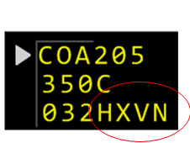
SIG1815 - Auto Handoff Data Comm Displays
Data Comm Held TOC and Field E in FDB display the same Facility ID and Position ID format:
Held TOC menu:
Field E in FDB Handoff data:
032HVXX
Held TOC for COA205 displayed data:
To Facility = V (Locally adapted Single Character Facility ID for Vancouver)
To Sector = XX (RTA Sector ID)
Preferred Frequency = 132.700 (RTA Frequency)
Dropdown menu = Empty
  No alternate frequencies are in the dropdown menu, as only the Preferred Frequency is present. There are no other frequencies adapted for Position XX.
Held TOC & Field E in FDB have the same representation for the CAATS Position ID

Slide 55

SIG1815 - Data Comm CONTACT TOC Validation Logic Paths
Data Comm release Held TOC processing on CONTACT (uM117) message.
  Controller Action 1: Controller uplinks Held TOC with RTA Frequency selected. Data Comm assembles CONTACT message entirely with RTA inputs, without additional frequency validation checks.
    CONTACT (uM117) Message constructed using all RTA input parameters:
            CONTACT VICTORIA APPROACH 132.700 MHZ
    where
    [ICAOfacilityname] = VICTORIA (RTA Facility Name)
    [ICAOfacilityFunction] = APPROACH (RTA Facility Function)
    [Frequency] = 132.700 (RTA Frequency)
  Controller Action 2: Controller uplinks Held TOC with Locally Adapted Frequency selected. Data Comm assembles CONTACT message with RTA Facility Name and RTA Facility Function and locally adapted controller entered frequency. Baseline validation checks occur.
    CONTACT (uM117) Message constructed using RTA Facility Name and RTA Facility Function input parameters:
            CONTACT VICTORIA APPROACH 135.325 MHZ
    where
    [ICAOfacilityname] = VICTORIA (RTA Facility Name)
    [ICAOfacilityFunction] = APPROACH (RTA Facility Function)
    [Frequency] = 135.325 (Controller input frequency locally adapted for Vancouver)
Controller selected 132.700 (RTA Frequency)
Controller selected 132.325 from the dropdown menu or manually entered

Slide 56
SIG 1815 – Auto Handoff
Non-US UH Command Format Used
Uplink Held TOC (UH) Command
  The command currently supports at a minimum to release a Held TOC entry of:
    UH with flight identifier
    UH with Facility ID and flight identifier
    UH with Facility ID and Sector ID with flight identifier
  When more than one Held TOC exists for the destination facility associated with the given flight identifier, then either UH command entry 1 or 2, will result in the following reject response displayed:
  REJECT – MULTIPLE HELD TOCS FOR SPECIFIED FACILITY
  The controller would then go to Held TOC Menu to select which TOC to upload or re-enter the command specifying the Facility ID & Position ID (#3) to release the TOC.
  The controller may include a designated adapted frequency associated with the TOCToFacility (Facility ID) in any of the three UH command input formats, if a different frequency other than the preferred frequency is desired.

Slide 57
SIG 1815 – Auto Handoffs Transition Plan
Handoff transition includes the use of a new transition switch for handoff to allow for the manual enabling/disabling of the automated handoff functionality.
  The switch is part of facility adaptation and is available for all Non-US facilities (not just a CAATS Non-US facility)
The switch is dynamic and can be modified (Enable/Disable) via the CP command or viewed using the EP command.
  The dynamic nature of the data item provides flexibility to each ERAM site with respect to when they enable the automated handoff function with an individual site (e.g., overnight) and when they fall back to using the manual procedures (e.g., either during peak hours or if an issue is discovered in the handoff function)
The transition switch must also be reset from Enabled to Disabled if the interface between ERAM and an adjacent CAATS facility falls back to using the current NADIN interface rather than Direct IP.
  SIG1814 added the upgraded Direct IP interface for CAATS and includes the ability, via the M&C position, to fallback to using the legacy NADIN interface.
  Automated handoff messages are not supported on the NADIN interface. Therefore, if the interface with a CAATS facility is switched from Direct IP back to NADIN (NADIN interface Enabled) then the corresponding radar handoff switch in facility adaptation is also, if needed, reset from Enabled to Disabled.
  This ensures that, for example, automatic control assignment and other functions that apply in a non-radar handoff environment are fully operational after the interface is set to NADIN.
  In a similar manner, entry of a CP command to enable radar handoff will be rejected if the Non-US facility is using the NADIN interface.

Slide 58
SIG 1815 – Auto Handoffs Transition Plan (cont.)
The CP command can be used to disable automated handoff to a CAATS facility while a handoff is in progress with the CAATS facility. When this occurs:
  The local handoff recipient sector (inbound handoff) or the handoff originating sector (outbound handoff) can still either accept or retract the handoff and clear the handoff state.
  However, the corresponding RTA message cannot be sent to the CAATS facility due to the disabling of automated handoff and the controller will see FAIL in Field E of their data block.
  This behavior is identical to a situation in which the interface to an adjacent facility has failed during a handoff.
  SIG1815 is not proposing any modifications to this behavior.
  In a similar manner, if the interface to a CAATS facility falls back to NADIN during a handoff then the radar handoff switch will be reset to Disabled as described in the previous slide and a controller will see FAIL in the data block when the handoff is accepted or retracted.

Slide 59
Backup Charts

Slide 60
SIG 1815 – Auto Handoff
Example of Non-US Held TOC & CONTACT Message Content based on RTA
Upon receipt of RTA, Data Comm will create a Held TOC Data entry associated with the the flight.
  RTA contains Facility ID (CYVR), Sector ID (XX), Frequency (132.700), Facility Name (VICTORIA), Facility Function (APPROACH)
The displayed Held TOC for this Held TOC Data contains:
  Facility ID = V (Single Character Adapted Facility ID for Vancouver)
  Sector ID = XX (RTA Sector ID)
  Preferred Frequency = 132.700 (RTA Frequency)
  Alternate Frequencies = None in this example, only the preferred frequency is present. So it is not listed as an alternate frequency for the Position.
Released TOC message content displayed in Full Text Message format (uM117 + uM161):
CONTACT VICTORIA APPROACH 132.700 MHZ END SERVICE
where purple text represents the RTA data inputs from NAV CANADA.

Slide 61
SIG 1815 –Examples of Non-US RTA, Held TOC Menu & Full Text Message (1 of 4)
CAATS Sector XX & Frequency 132.7 associated with VANCOUVER CENTER
Upon receipt of RTA, Data Comm will create a Held TOC Data entry associated with the flight.
  RTA contains Facility ID (CYVR), Sector ID (XX), Frequency (132.700), Facility Name (VANCOUVER), Facility Function (CENTER)
Data Comm Held TOC Menu Computer Human Interface (CHI) display uses baseline functionality with Non-US facility data displayed.
Conceptual example of Held TOC with only a preferred frequency:
  FLID = ACA123
  Facility ID = V (Single Character Adapted Facility ID for Vancouver)
  Position ID = XX (RTA Sector ID)
  Preferred Frequency = 132.700 MHZ (RTA Frequency)
  Alternate Frequencies = None
Released TOC message content displayed in Full Text Message format (uM117 + uM161):
CONTACT VANCOUVER CENTER 132.700 MHZ END SERVICE

Slide 62
SIG 1815 –Examples of Non-US RTA, Held TOC Menu & Full Text Message (2 of 4)
CAATS Sector XX & Frequency 132.7 associated with VICTORIA APPROACH
Upon receipt of RTA, Data Comm will create a Held TOC Data entry associated with the flight.
  RTA contains Facility ID (CYVR), Sector ID (XX), Frequency (132.700), Facility Name (VICTORIA), Facility Function (APPROACH)
Data Comm Held TOC Menu Computer Human Interface (CHI) display uses baseline functionality with Non-US facility data displayed.
Conceptual example of Held TOC with only a preferred frequency:
  FLID = ACA435
  Facility ID = V (Single Character Adapted Facility ID for Vancouver)
  Position ID = XX (RTA Sector ID)
  Preferred Frequency = 132.700 MHZ (RTA Frequency)
  Alternate Frequencies = None
Released TOC message content displayed in Full Text Message format (uM117 + uM161):
CONTACT VICTORIA APPROACH 132.700 MHZ END SERVICE

Slide 63
SIG 1815 – Examples of Non-US RTA, Held TOC Menu & Full Text Message (3 of 4)
CAATS Sector AN & Frequency 132.9 associated with VANCOUVER APPROACH
Upon receipt of RTA, Data Comm will create a Held TOC Data entry associated with the flight.
  RTA contains Facility ID (CYVR), Sector ID (AN), Frequency (132.900), Facility Name (VANCOUVER), Facility Function (APPROACH)
Data Comm Held TOC Menu Computer Human Interface (CHI) display uses baseline functionality with Non-US facility data displayed.
Conceptual example of Held TOC with only a preferred frequency:
  FLID = ROU435
  Facility ID = V (Single Character Adapted Facility ID for Vancouver)
  Position ID = AN (RTA Sector ID)
  Preferred Frequency = 132.900 MHZ (RTA Frequency)
  Alternate Frequencies = None
Released TOC message content displayed in Full Text Message format (uM117 + uM161):
CONTACT VANCOUVER APPROACH 132.900 MHZ END SERVICE

Slide 64
SIG 1815 – Examples of Non-US RTA, Held TOC Menu & Full Text Message (4 of 4)
CAATS Sector KA & Frequency 132.35 associated with VANCOUVER CENTER
Upon receipt of RTA, Data Comm will create a Held TOC Data entry associated with the flight.
  RTA contains Facility ID (CYVR), Sector ID (KA), Frequency (132.350), Facility Name (VANCOUVER), Facility Function (CENTER)
Data Comm Held TOC Menu Computer Human Interface (CHI) display uses baseline functionality with Non-US facility data displayed.
Conceptual example of Held TOC with a preferred frequency and alternate adapted frequencies available for operational user’s selection:
  FLID = JZA326
  Facility ID = V (Single Character Adapted Facility ID for Vancouver)
  Position ID = KA (RTA Sector ID)
  Preferred Frequency = 132.350 MHZ (RTA Frequency)
  Alternate Frequencies = 133.600, 134.200 (displayed in the dropdown menu, whose presence is identified by the triangular indicator to the right of the preferred frequency)
Released TOC message content displayed in Full Text Message format (uM117 + uM161):
CONTACT VANCOUVER CENTER 132.350 MHZ END SERVICE

