Slide 1
NextGen Weather Systems Implementation
Common Support Services (CSS-Wx) &
NextGen Weather Processor (NWP)
Presented to: Salt Lake City NEMC / ARTCC
By: AJM-333
Date: September 2016

Slide 2
Purpose
Describe NextGen Weather Systems
  Common Support Services-Weather (CSS-Wx) being developed by Harris
  NextGen Weather Processor (NWP) being developed by Raytheon
Highlight activities associated with CSS-Wx and NWP system implementation
  Coordination activities
  Equipment at NEMC, ARTCC, and TRACON
  Training

Slide 3
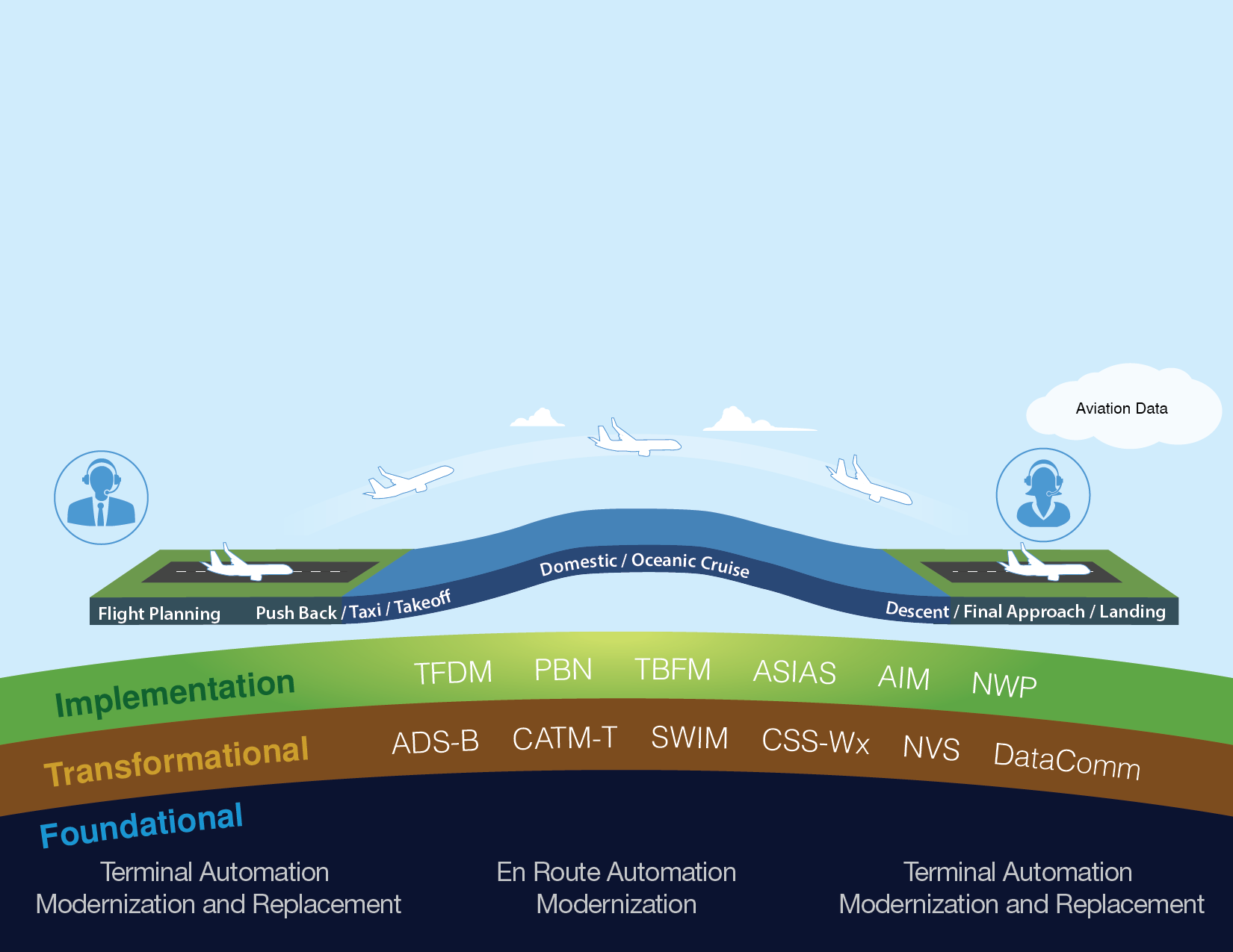
Delivering NextGen Improvements
Legacy System
NextGen
Radar
Inefficient Routes
Voice Communications
Disparate Information
Fragmented Weather Forecasting
Weather Restricted Visibility
Forensic Safety Systems
Nationwide Focus
Satellite
Performance Based Navigation (fuel savings)
Voice & Digital Communications
Automated Decision Support Tools
Integrated Weather Information
Improved Access in Low Visibility
Prognostic Safety Systems
Focus on Congested Metroplexes
https://www.faa.gov/nextgen/programs
3

Slide 4




Key Benefits of CSS-Wx and NWP
  $2.0B Cost Avoidance Over 25 Year Lifecycle Including $350M Ops Cost Savings
Reduce FAA
Operations Costs
  Eliminates Need for Legacy System
  Tech Refreshes
Modernize National
Airspace System
  Decommission Outdated Systems
  Leveraging SWIM and FTI
  Cloud Compatibility
  Global Data Standardization
  Over $2.8B of User Benefits
Improve Efficiency
  Reduce Flight Delays
  Enable Collaborative
  Decision-making
Improve Safety
  Enhanced Weather Information
  Greater Access
  Common Situational Awareness
Notes:
Back-up?

Slide 5
FAA NextGen Weather Systems Scope
Common Support Services – Weather (CSS-Wx)
  Provides a single source for FAA weather information and establishes enterprise level common support services using SWIM
  Focuses on weather information management, publishing to support users, and providing new interface standards and formats
  Consistent with global standards (e.g., WXXM)
  Provides geospatial data access services (WFS, WCS, WMS, WMTS)
  Enables decommissioning of legacy weather dissemination systems (e.g., WARP WINS, FBWTG, CDDS)
NextGen Weather Processor (NWP)
Produces advanced aviation specific weather products
  0 to 8 hour aviation weather products
  Real-time weather radar information (e.g., ERAM)
  Convective Weather Avoidance Fields
  Wind Shear alerts
Translates weather information into weather avoidance areas for integration into decision support tools (e.g., TFMS, TBFM)
Provides Aviation Weather Display (AWD) of NextGen weather information for ATC users
Enables decommissioning of legacy weather processor systems (e.g., WARP, ITWS, CIWS)

Slide 6
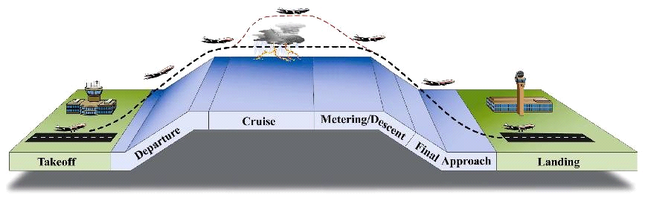
FAA NextGen Wx Systems in NAS
  Establish common weather data standards
  Consolidate FAA legacy weather systems
  Improve aviation weather prediction capabilities
  Publish weather information for all users across the NAS
Efficient, Flexible Routing
Reduce Weather Impact
All-weather
Departures
All-weather Approaches
Current Wx Systems | ITWS | ITWS WARP | CIWS WARP | ITWS WARP | ITWS
NextGen Wx Systems | CSS-Wx and NWP

Slide 7
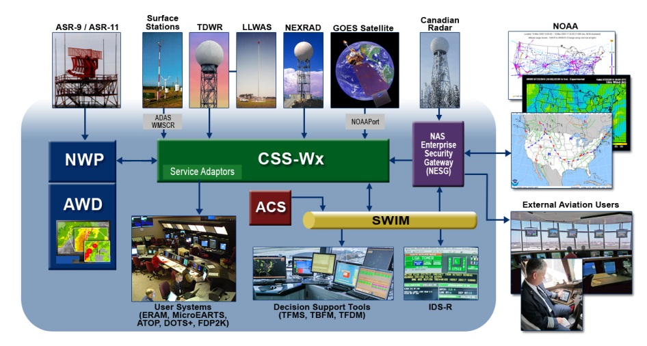
NextGen Wx Providers/Consumers

Slide 8
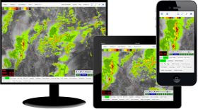
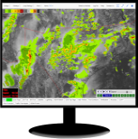
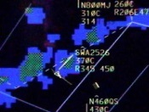
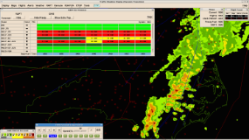

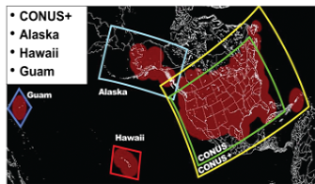
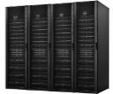

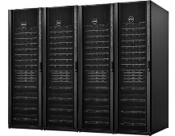




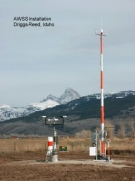

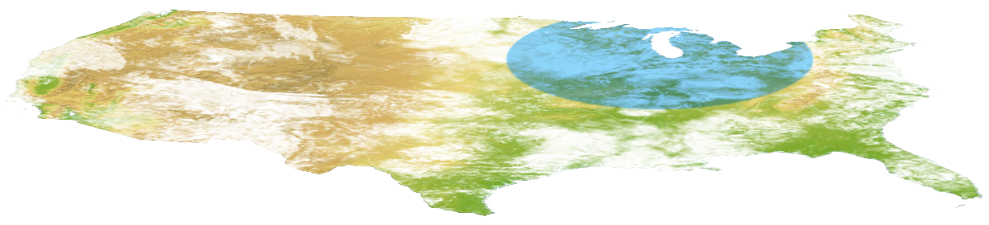



FAA NextGen Wx Systems Architecture
ATCTs
Flight Services, Providers, Airlines
TRACONs
Aviation
Wx Display (AWD)
AWD replaces legacy displays: WARP BT, CIWS SD, ITWS SD, ITWS Web, CIWS Web
CERAPs
ARTCCs
Legacy Weather
Consumers
Modern Weather
Consumers
External Weather
Consumers
Stakeholders
NAS Web Users
ATCSCC
NESG
NESG
NextGen Weather
Processor (NWP)
System Wide
Information
Management
(SWIM)
Central & Terminal Processors
Aeronautical
Information
Management
Modernization
(AIMM)
Service
Adaptors
Common Support Services –
Weather (CSS-Wx)
ARTCC & Terminal Domains
CONUS+
Domain
Canadian
Wx Radars
WMSCR/
ADAS
MDCRS
Satellite
ASR
LLWAS/TDWR
Lightning
Networks
Surface Obs
Networks
NOAA Data
NEXRAD

Slide 9
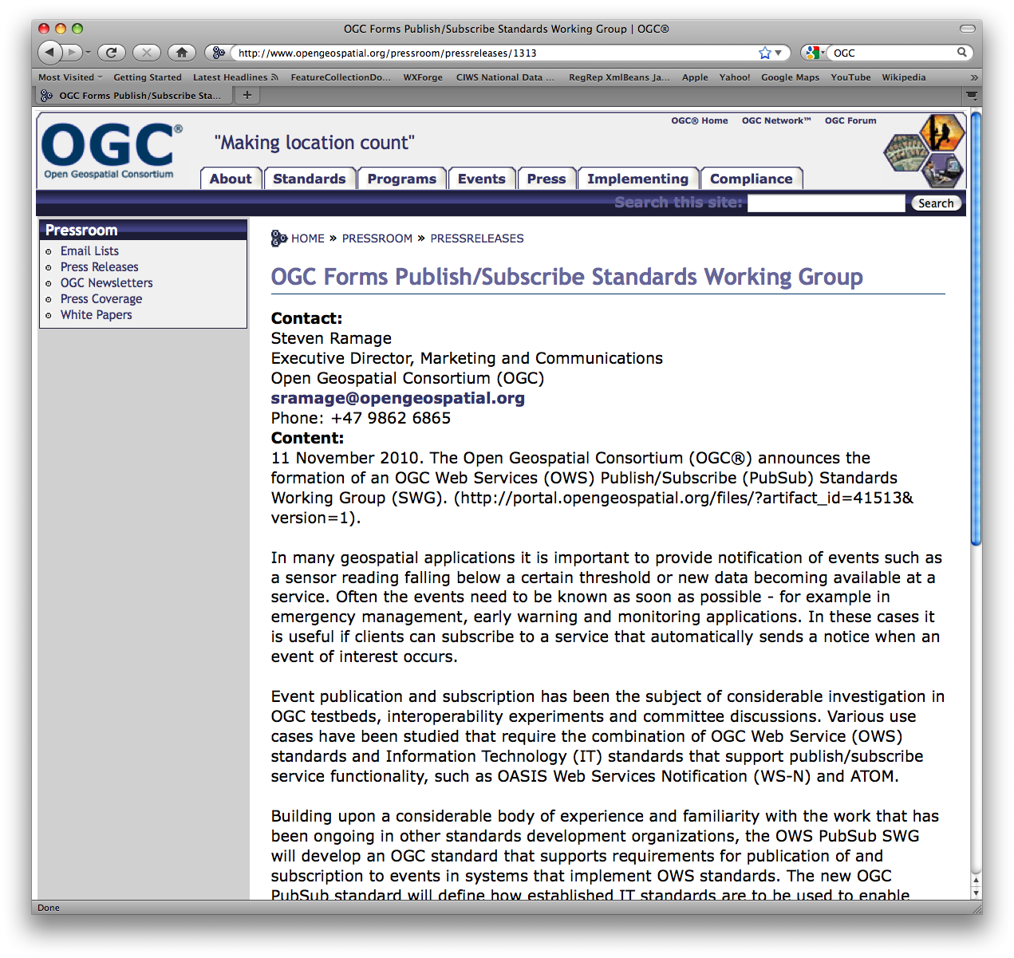
CSS-Wx Data Access Services
Ingests weather sensor, NWP data and NOAA data (e.g. Satellite, models)
Makes weather data available through Web Services
Adheres to international standards for handling and representing geospatial data
Consumers subscribe to CSS-Wx products through SWIM
  Web Service Description Documents (WSDDs)
  Product Description Documents (PDDs)
  Sample data
  Client Library / Software
Web Coverage Service
Web Feature Service
Web Map Service
Renders weather data as single large image or sets of tiled images for display
JPEG, PNG, GIF, KML format
Filters and transforms large gridded dataset
NetCDF format
Filters and transforms non-gridded data sets
WXXM 2.0 XML format
Filters and transforms non-gridded datasets
WXXM 2.0 XML format
Filters and transforms large gridded datasets
NetCDF format

Slide 10




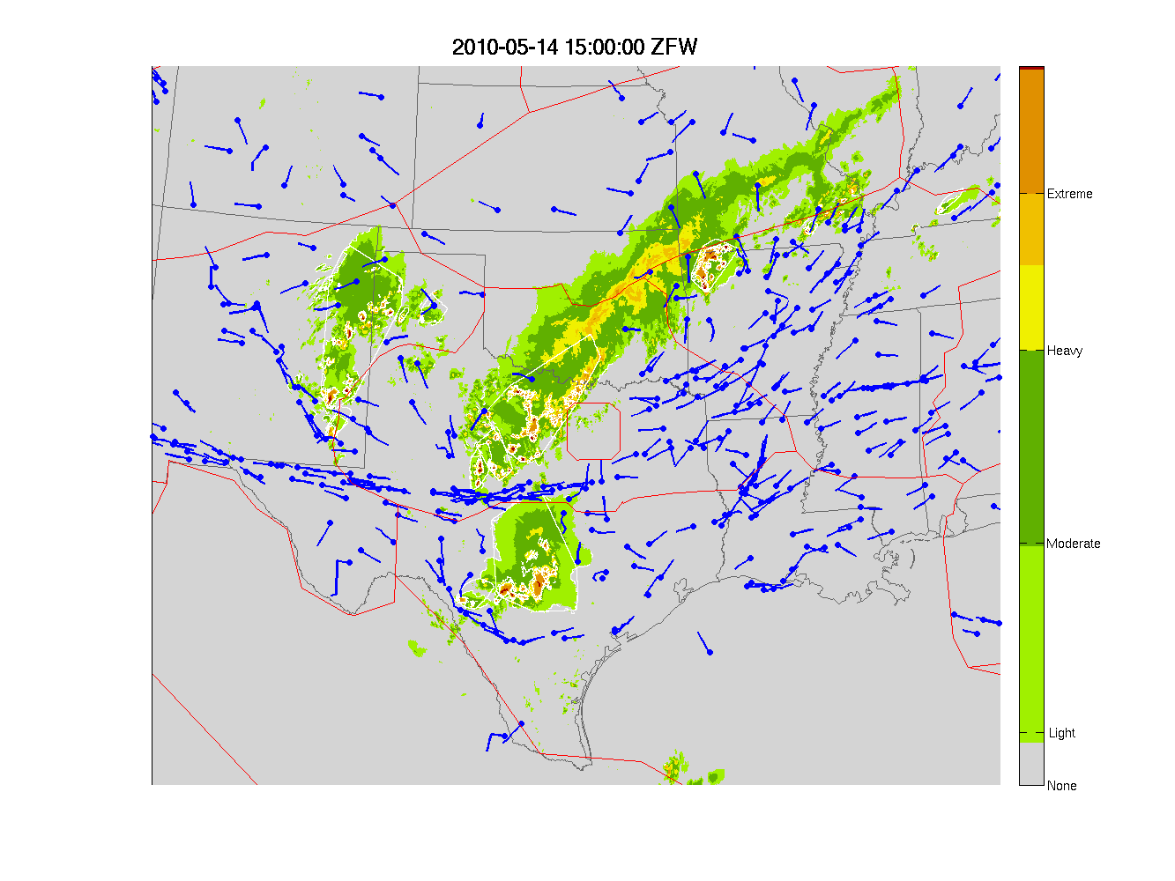
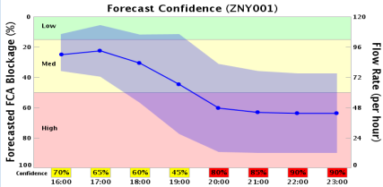
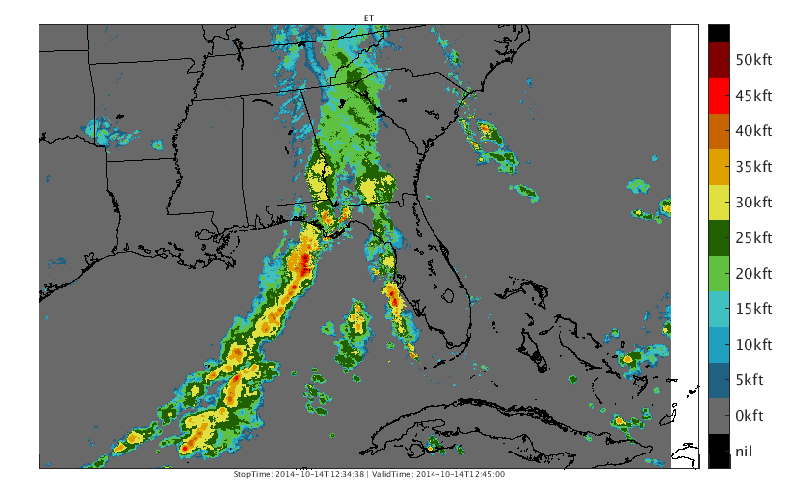
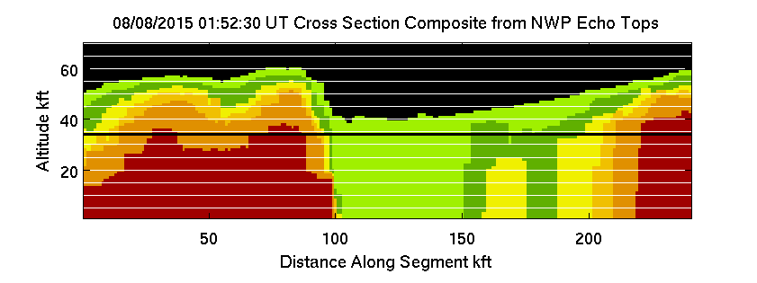
Current and Future NWP Products
Convective Weather
Avoidance Polygons
Forecast Confidence
Offshore Precipitation
4D Trajectory Weather
Per-Radar
Processing
Mosaic
Analysis
0-8 hour
Prediction
Weather
Avoidance
Scoring
Post
Processing
NextGen Weather Processor (NWP) Product Generation Platform

Slide 11
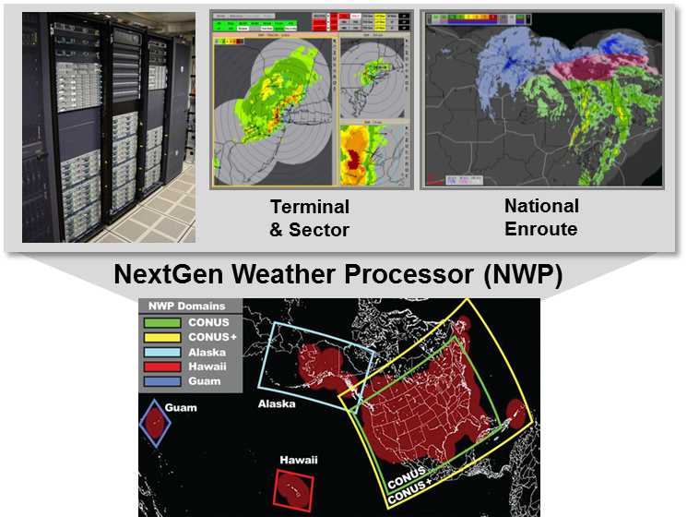

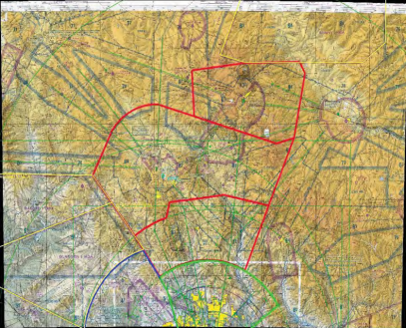
Safety Improvements
New architecture makes terminal safety products available domain-wide
New processing enables rapid convective growth detection
New products provide low-cost options for expanding terminal weather coverage
Convective Growth Hazard
TRACON Expansion
Phoenix AZ

Slide 12
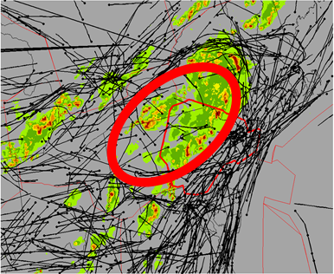
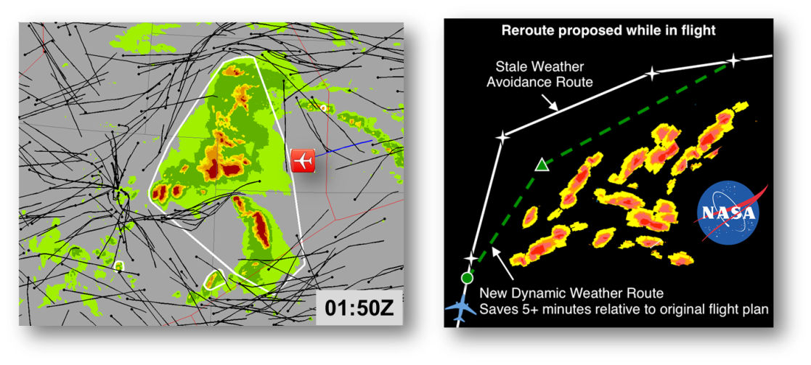
Efficiency Improvements
Decision Support for Strategic Traffic Flow Management
Operational implementation of 0-8 hour “radar-forward” predictions
Translation of weather products into pilot avoidance metrics
Enables decision support tool development with tailored access via SWIM
4D Flow Constrained Areas
Efficient In-flight Reroutes

Slide 13
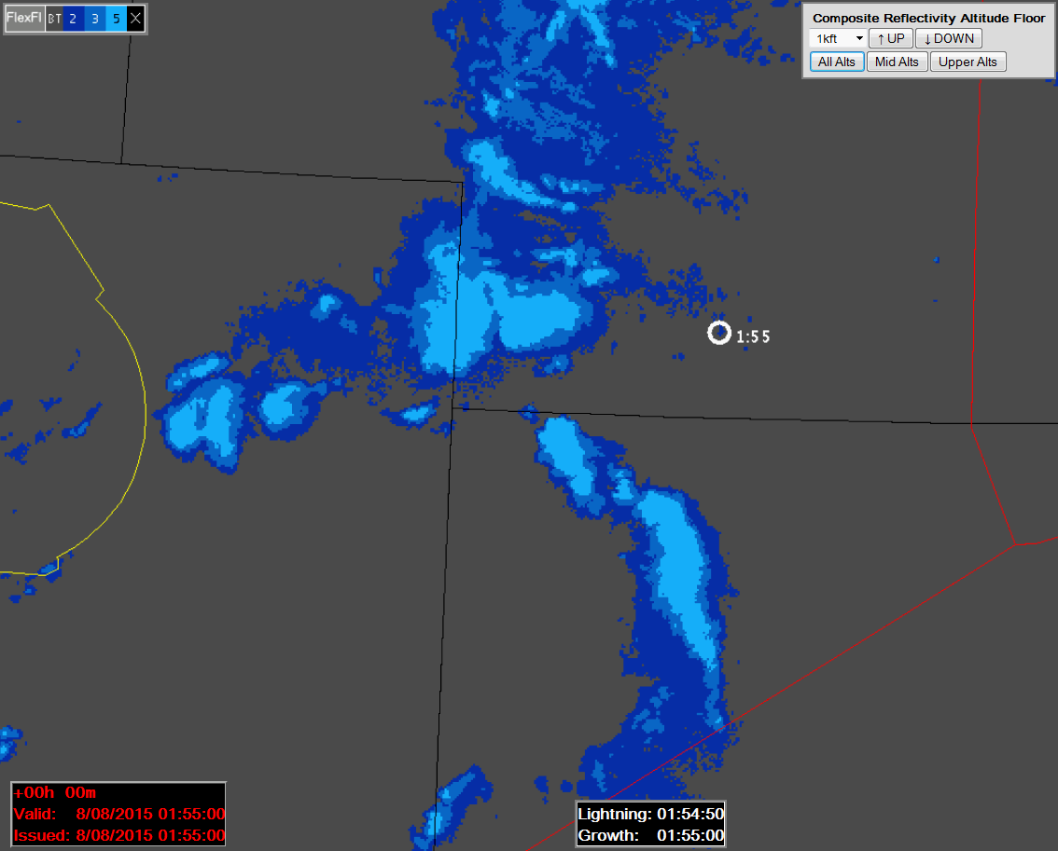
NextGen Flexible Layer Mosaics
NWP reflectivity mosaics update every 25 sec
  New volumes are created with each new radar tilt
  All tilts are time-aligned in each new volume
  Trends are computed between ‘like’ volumes
  All volume products are time-aligned in making multi-radar mosaics
Example shows Composite Reflectivity from “floor” to 60 Kft
Layer bottom (“floor”) and layer top (“ceiling”) selectable in 1 Kft increments
NextGen Weather radar mosaics contain fine-scale vertical storm structure

Slide 14
Integrated NWS Products on AWD
Several NWS alphanumeric products
  METARS, PIREPs, etc.
CSS-Wx Hosted Algorithms provide user-selected composite layers and contours for 8-hour forecast
  CIP, FIP Icing
  GTG Turbulence
Integrate display of Icing and Turbulence with NWP 0-8 hour radar products

Slide 15
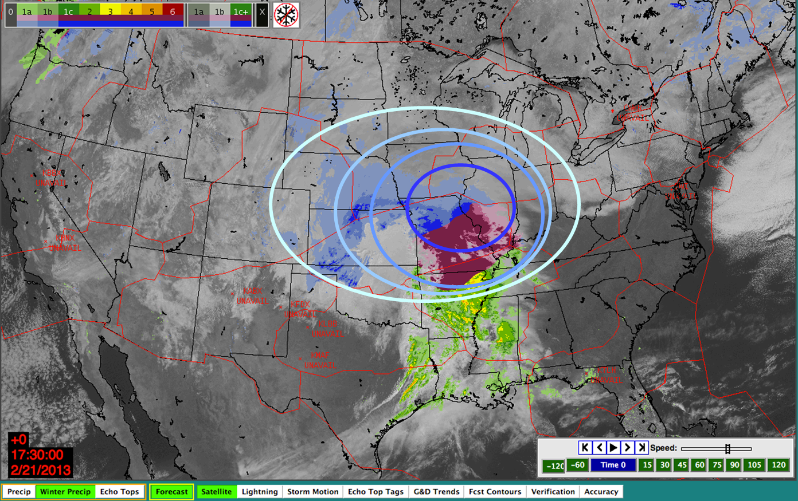
AWD Integrated Icing and Turbulence
Example Mock-Up:
Icing Contours
overlaid on NWP
radar mosaics

Slide 16
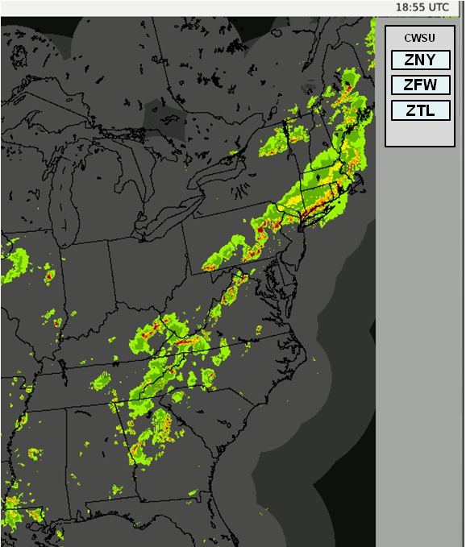
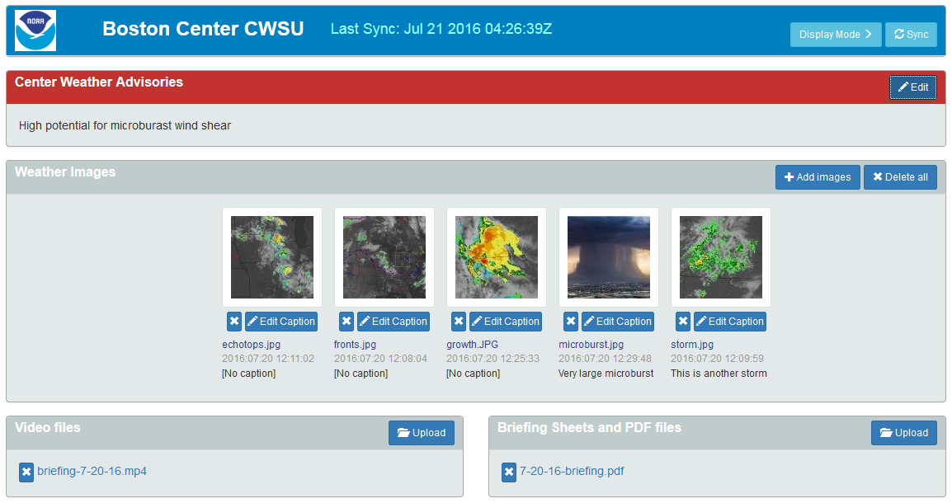
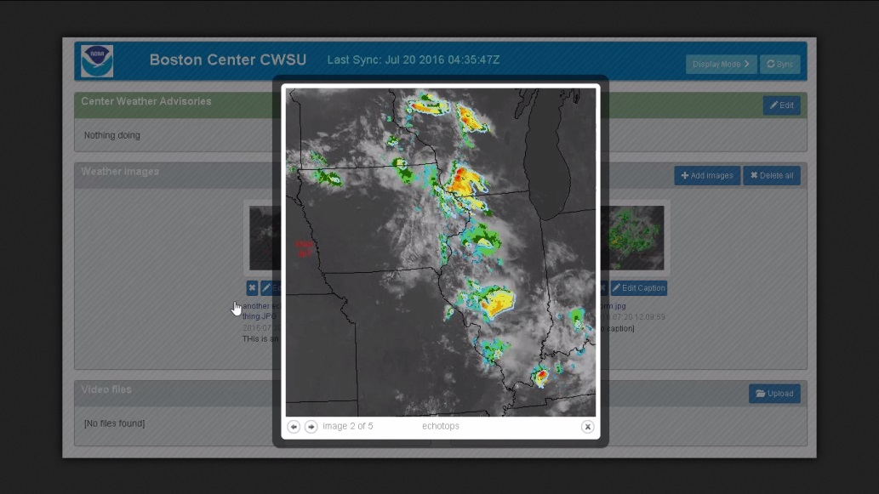
AWD View on CWSU
AWD access to tailored static CWSU Briefing web page
  No open internet access – only view meteorologist’s selection
User configures favorite CWSU buttons
ZBW

Slide 17
AWD NAS Users
Facility | # of Facilities | # of WARP BT | # of ITWS SD | # of CIWS SD | Total Displays
ATCSCC | 1 | 13 | 2 | 13 | 28
ARTCC | 21 | 249 | 46 | 79 | 374
CERAP | 2 | 7 | 2 | 0 | 9
HCF | 1 | 5 | 0 | 0 | 5
TRACON | 17 | 4 | 62 | 9 | 75
ATCT/TRACON | 32 | 1 | 87 | 3 | 91
ATCT | 43 | 0 | 50 | 5 | 55
Operational Facilities TOTAL: | 117 | 279 | 249 | 109 | 637
Support | 2 | 0 | 114 | 0 | 114
Test | 1 | 28 | 6 | 1 | 35
Other | 1 | 3 | 0 | 0 | 3
Region | 1 | 0 | 0 | 2 | 2
Support and Other Facilities TOTAL: | 5 | 31 | 120 | 3 | 154
All Facilities TOTAL: | 122 | 310 | 369 | 112 | 791

Slide 18
NextGen Weather Systems T&E
2
3
4
6
7
9
10
Software
Testing
(informal)
Functional
Qualification
Test (informal)
Factory
Acceptance
Test
Integration
Test
System
Test
Production
Acceptance
Test
Site
Acceptance
Test
Prime Contractor facility
WJHTC
Contractor facility
Fielded sites
Test Capability Accreditation
1
Regression
Test
5
Regression
Test
8
FAA Power
Test
1
#
Prime Contractor Activity
ROC NEXRAD
Certification
#
Contractor -Supported Activity
2
3
5
7
8
9
Operational
Testing
(Part 1)
Key Site
Test
Operational
Testing
(Part 2)
Independent
Operational
Assessment (IOA)
CSS-Wx and NWP
Interoperability
Test
WJHTC
Fielded sites
WJHTC
Assessment Authorization
Analysis
4
Regression
Test
6

Slide 19
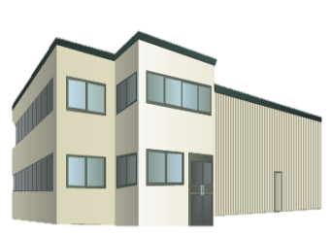
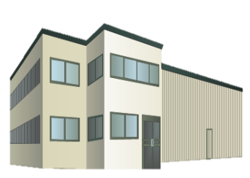





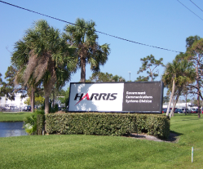

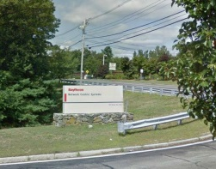
Integrated Facility Implementation
CSS-Wx
NWP
CSS-Wx
NWP
Salt Lake City
Atlanta
CSS-Wx
AWDs at all Sites
ATCTs
(Approx. 60)
ATCSCC
CSS-Wx
(1 per site)
CSS-Wx
NWP
21 ARTCCs
33 TRACONs / 3 CERAPs*
*ZSU Only (NWP)
Test Facilities
NWP
CSS-Wx
(1st Article)
MMAC/PSF
CSS-Wx
NWP
NWP
(1st Article)
Harris

Slide 20
CSS-Wx/NWP APB Milestones
Milestone | CSS-Wx | NWP
Final Investment Decision (FID) | March 2015 | March 2015
Contract Award | June 2015 | June 2015
Preliminary Design Review (PDR) Completed | March 2016 | June 2016
Critical Design Review (CDR) Completed | September 2016 | December 2016
Factory Acceptance Test (FAT) Completed | March 2018 | February 2019
Operational Test (OT) Completed | November 2018 | May 2020
Key Site Initial Operational Capability (IOC) | January 2019 | August 2020
In Service Decision | September 2019 | April 2021
First Site Operational Readiness Date (ORD) | October 2019 | May 2021
Last Site ORD | August 2022 | August 2022
✓
✓
✓
Contract awarded April 2015
Working schedule is ahead of APB
Key:
Complete
On Track

Slide 21


CSS-Wx/NWP Implementation
Current Wx Dissemination:
WARP WINS
CDDS
ITWS Web Server
CREWS
Contract Award: April 2015
CSS-Wx
IOC
ORD
CSS-Wx Work Package 1
Legacy Wx Dissemination:
WMSCR
ADAS
ALDARS
WIFS
IARD
CSS-Wx Work Package 2
Current Wx Processing:
WARP RAMP
CIWS
ITWS
Contract Award: April 2015
NWP
IOC
ORD
NWP Work Package 1
IARD
NWP Work Package 2
NWP Work Package 3
CY 2015 2020 2030 2040
Notes:
21
21
21
21
21

Slide 22
Implementation Coordination

Slide 23
Implementation Coordination
AJM-333 coordinating implementation activities for CSS-Wx and NWP
  Site surveys
  Site preparation
  and installations
Implementation activities for both Programs may occur at different times for a given site
Exploring feasibility of conducting CSS-Wx and NWP Site Surveys at the facilities at the same time

Slide 24
Implementation Coordination Activities
Submit Needs Assessment Programs (NAP) entries for Engineering Services Support
Coordinate with Program Implementation Managers (PIMs)
Submit Case Files / NAS Change Proposals (e.g.)
  Connection to Facility Critical Power (Power NCPs)
  Base-lining of requirements (e.g. SSDs, IRDs, WSRDs)
  Key Site Test NAS Change Proposals (NCPs)
Coordinate completion of applicable items on Operational Integration Board (OIB) Checklist and applicable In Service Review (ISR) Checklists

Slide 25
Installation Activities
Working with Harris and Raytheon on the number of installation teams for CSS-Wx and NWP, respectively
  Each Contractor plans on multiple teams to install in parallel at different parts of the country
    Harris: 3 to 4 installation teams
    Raytheon: 3 installation teams
Approach is to install CSS-Wx equipment at facilities ahead of NWP
Coordinate deployment sequence for both CSS-Wx and NWP
Install at Key Site Systems
Deploy systems at remainder of sites
Each Vendor will utilize multiple deployment teams

Slide 26
Transition Planning
CSS-Wx and NWP Programs are conducting transition planning
  Minimize impact to users during implementation / transition
  Transition users from legacy weather systems to NextGen
As part of the CSS-Wx and NWP Implementation, the systems will need to co-exist with legacy for a period of time
Dual Operations will occur as much as possible during transition period
  Acquisition of information from data sources will occur simultaneously
    e.g., NEXRAD, TDWR
  Display of Information
    Legacy Weather Displays along with AWDs

Slide 27
CSS-Wx and NWP Key Sites
Key Site Locations |  | Facility Type | CSS-Wx Key Sites | NWP Key Sites
Area | Facility Name |  | Node | Processor | AWD
Atlanta Area
 | Atlanta NEMC | NEMC | C Node | Domain
 | Atlanta TRACON (A80) | TRACON | T Node | Terminal | Dedicated
 | Atlanta ARTCC (ZTL) | ARTCC | D Node |  | Dedicated
 | Atlanta Tower (ATL) | ATCT |  |  | Dedicated
 | Dekalb-Peachtree Tower (PDK) | ATCT |  |  | Dedicated
Salt Lake City Area
 | Salt Lake City NEMC | NEMC | C Node | Domain
 | Salt Lake City TRACON (S56) | TRACON | T Node | Terminal | Dedicated
 | Salt Lake City ARTCC (ZLC) | ARTCC | D Node |  | Dedicated
 | Salt Lake City Tower (SLC) | ATCT |  |  | Dedicated
New York Area
 | New York ARTCC (ZNY) | ARTCC | D Node |  | Dedicated
Central Florida Area
 | Central Florida TRACON (F11) | TRACON | T Node | Terminal | Dedicated
 | Jacksonville ARTCC (ZJX) | ARTCC | D Node |  | Dedicated
 | Tampa Tower (TPA) | ATCT |  |  | Dedicated
 | Orlando Tower (MCO) | ATCT |  |  | Dedicated
 | Daytona Beach Tower (DAB) | ATCT |  |  | Dedicated
 | Fort Myers Tower (RSW) | ATCT |  |  | Dedicated
 | Sanford Tower (SFB) | ATCT |  |  | Dedicated
NOTE: Key Sites are identified in Green Highlights

Slide 28
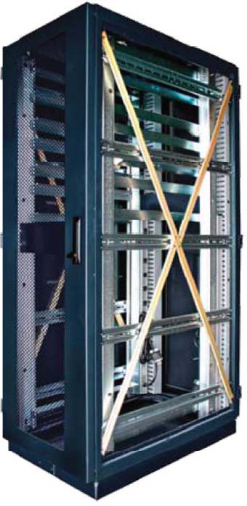
CSS-Wx and NWP Combined Rack Count
  Central Node – 4 to 6 Racks
    ARTCC – 2 Racks
      ATCSCC – 1 Rack
        TRACON – 2 Racks
          WJHTC\PSF – 4\4 Racks
            CERAP – 1 Rack
              CERAP, San Juan – 2 Racks
Equipment at:
  2 NEMCs
  21 ARTCCs,
  3 CERAPs
  33 TRACONs
  ATCSCC
Note: Quantities are subject to change based on Critical Design Review

Slide 29
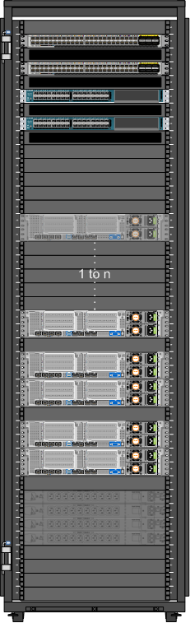
CSS-Wx Central Site Hardware – Rack 1
CSS-Wx Switch_C
Hardware: Cisco Nexus 9300 Switch (N9K-C9372PX)
Quantity: 2
Features:
48 - 10G SFP+ Ports
6 - 40G QSFP+ Ports
Cisco Virtual PortChannel (vPC)
Both switches to look and function as one switch
When redundant connections are present and configured, bandwidth is doubled
In event of failure, remaining switch handles full communications

Slide 30
CSS-Wx Central Site Hardware – Rack 1
Fabric Interconnect
Hardware: Cisco UCS Fabric Interconnect (UCS-FI-6248PUP)
Quantity: 2
Features:
32 - Unified Ports
Combines Communication and Storage traffic over redundant paired 40G connections
Cisco UCS Manager
Allows for full configuration of all connected servers
  BIOS, Firmware, UUIDs, WWIDs, etc…

Slide 31
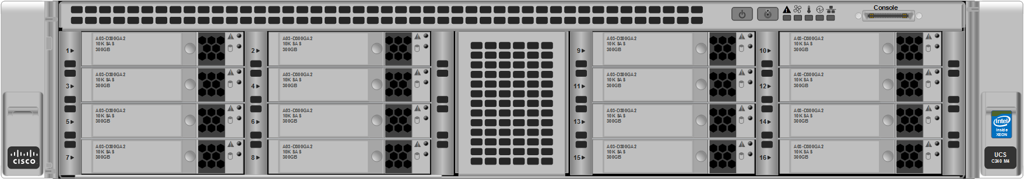
CSS-Wx Central Site Hardware – Rack 1
Storage Node
Hardware: Cisco UCS C240 M4 (UCSC-C240-M4L)
Quantity: 5 (1-to-n architecture allows for future growth)
Features:
CPU - Two 6-core 1.90 GHz Intel Haswell (E5-2609)
RAM - 96 GB
HDD - Two 480 GB SDD (OS)
- Twelve 6 TB SAS 7.2K RPM HDD (Storage)
Will utilize GlusterFS to handle distributed storage

Slide 32
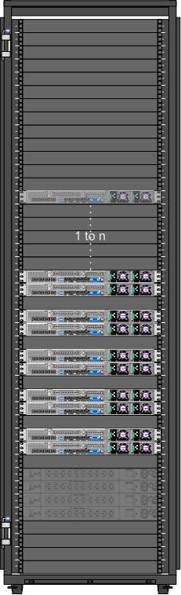
CSS-Wx Central Site Hardware – Rack 2
Compute Node_C
Hardware: Cisco UCS C220 M4 (UCSC-C220-M4S)
Quantity: 10 (1-to-n architecture allows for future growth)
Features:
HDD - Two 480 GB SSD (OS)
CPU - Two 12-core 1.80 GHz Intel Haswell (E5-2650L)
RAM - 384 GB
Host for all Virtual Machines

Slide 33
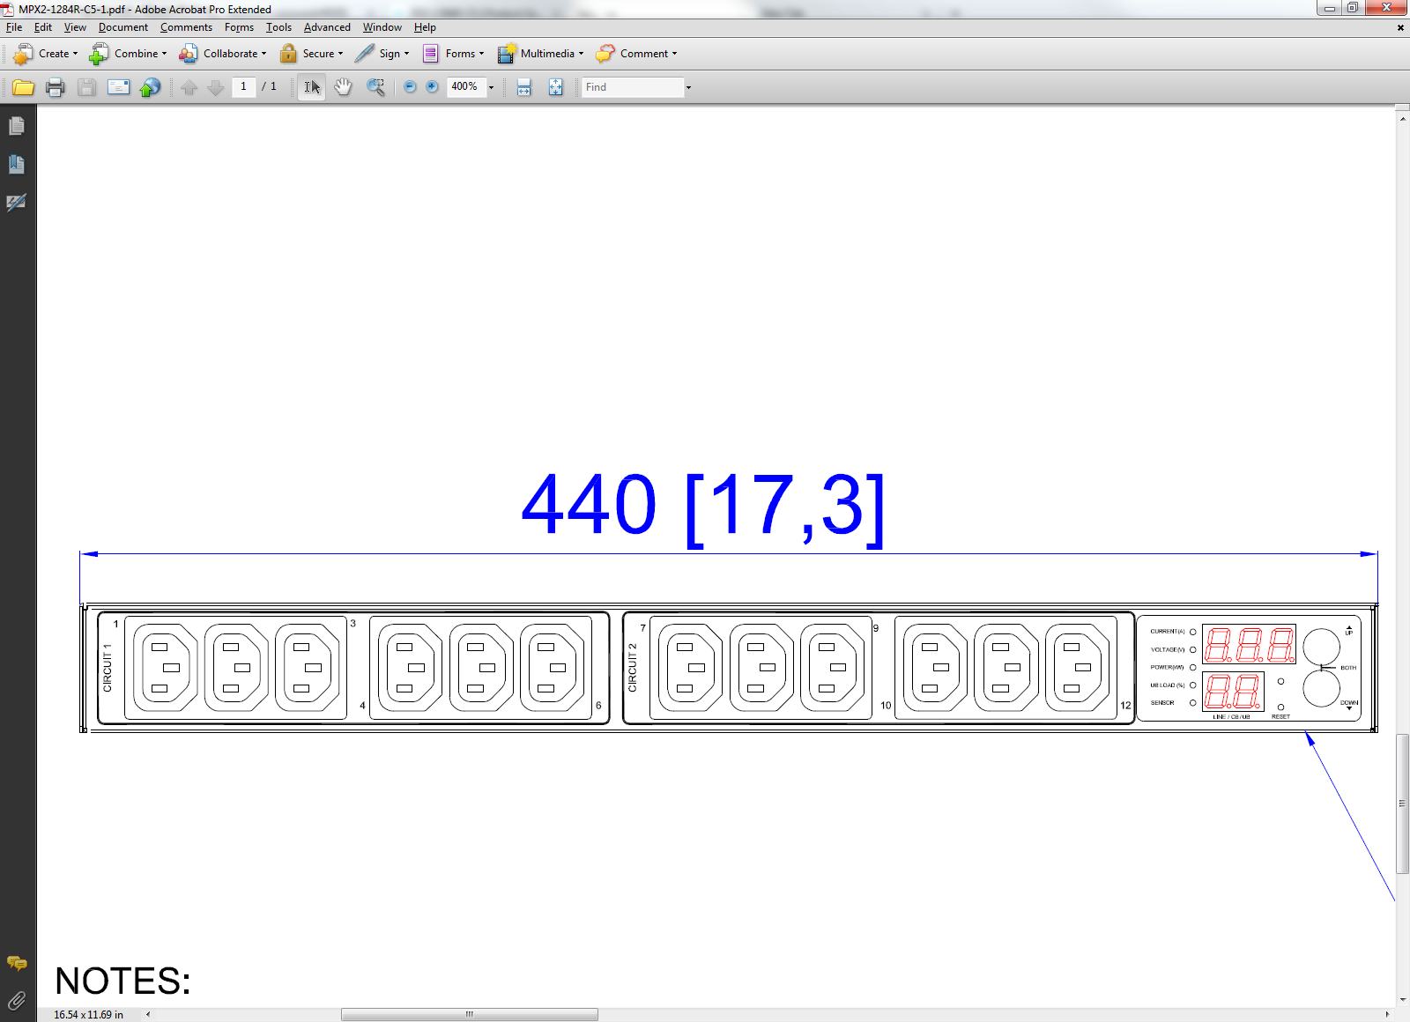
CSS-Wx Central Site Hardware
PDU
Hardware: Raritan PX2-1284R-C5
Quantity: 4 per rack (Central)
2 per rack (Terminal and Distribution)
Features:
Outlets - 12 C13 Outlets
Current - 20 or 30 Amps
Plug - L6-20P or L6-30P
“Smart” PDU which can be monitored via network using SNMP

Slide 34
NWP Central Site Design Block Diagram
NWP Servers
Qty 12 Dell PowerEdge R630 Server
2 Hot Failover Clustering (HFC),
9 Product Generation (PG) with 1 Spare PG Each with
Qty 2 Intel Xeon E5-2699 v4 2.2 GHz, 22 Core 44 Thread
512 GB Memory, 2.4 TB Storage, DVD 2 x 100Gb , 2 x 10Gb, 2 x 1Gb Interfaces iDRAC8 Management, Dual Power Supply
Storage Array
Dell PowerVault MD3800i, 10G iSCSI, 2U-12 drive array
Qty 12 6TB Hard Drive 48 TB Total Dual Power Supply
100 Gb
1Gb Maint
12
1Gb Maint
10 Gb
FTI
12
12
40 Gb
13
1Gb Manually Configured
40 Gb
Backup
100G High Performance Computing
1Gb
10G Utility Network
Qty 2 Dell Force10, S4820T, 48 x 10GBase-T ports
Network
40 Gb
Maint
1Gb
Qty 2 Dell Networking Z9100-ON
32 x 100Gb ports
1Gb
100 Gb
Maint
10 Gb
Maintenance Laptop
Dell Inspiron 15 3000 Series Non Touch Intel® Core™ i3-5005U Processor
(3M Cache, 2.00 GHz)
4GB RAM, 500GB Hard Drive
1Gb Maint
Preliminary Design
10 Gb
12 Rev 3
CSS-WX

Slide 35
ARTCC Equipment

Slide 36
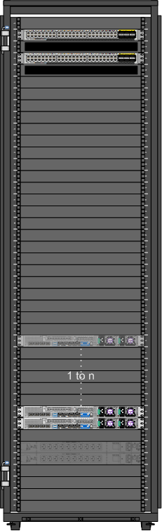
CSS-Wx Distribution Site Hardware
CSS-Wx Switch_D
Hardware: Cisco Nexus 9300 Switch (N9K-C9372TX)
Quantity: 2
Features:
48 - 1/10G Ethernet Ports
6 - 40G QSFP+ Ports
Cisco Virtual PortChannel (vPC)
Both switches to look and function as one switch
When redundant connections are present and configured, bandwidth is doubled
In event of failure, remaining switch handles full communications

Slide 37
CSS-Wx Distribution Site Hardware (Cont.)
Compute Node_D
Hardware: Cisco UCS C220 M4 (UCSC-C220-M4S)
Quantity: 2 (1-to-n architecture allows for future growth)
Features:
CPU - Two 12-core 1.80 GHz Intel Haswell (E5-2650L)
RAM - 320 GB
HDD - Two 480 GB SSD (OS)
- Four 1.8 TB SAS 10K RPM HDD (Storage)
I/O - 2 Dual Port 10GB NIC (4 total)
- 2 Quad Port 1GB NIC (8 total)
Host for all Virtual Machines
Will utilize GlusterFS to handle distributed storage

Slide 38
TRACON Equipment

Slide 39
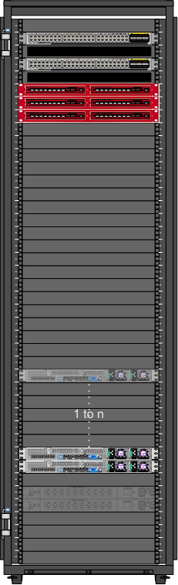
CSS-Wx Terminal Site Hardware
CSS-Wx Switch_T
Hardware: Cisco Nexus 9300 Switch (N9K-C9372TX)
Quantity: 2
Features:
48 - 1/10G Ethernet Ports
6 - 40G QSFP+ Ports
Cisco Virtual PortChannel (vPC)
Both switches to look and function as one switch
When redundant connections are present and configured, bandwidth is doubled
In event of failure, remaining switch handles full communications

Slide 40
CSS-Wx Terminal Site Hardware (Cont.)
Compute Node_T
Hardware: Cisco UCS C220 M4 (UCSC-C220-M4S)
Quantity: 2 (1-to-n architecture allows for future growth)
Features:
CPU - Two 12-core 1.80 GHz Intel Haswell (E5-2650L)
RAM - 320 GB
HDD - Two 480 GB SSD (OS)
- Four 1.8 TB SAS 10K RPM HDD (Storage)
I/O - 2 Dual Port 10GB NIC (4 total)
- 2 Quad Port 1GB NIC (8 total)
Host for all Virtual Machines
Will utilize GlusterFS to handle distributed storage

Slide 41
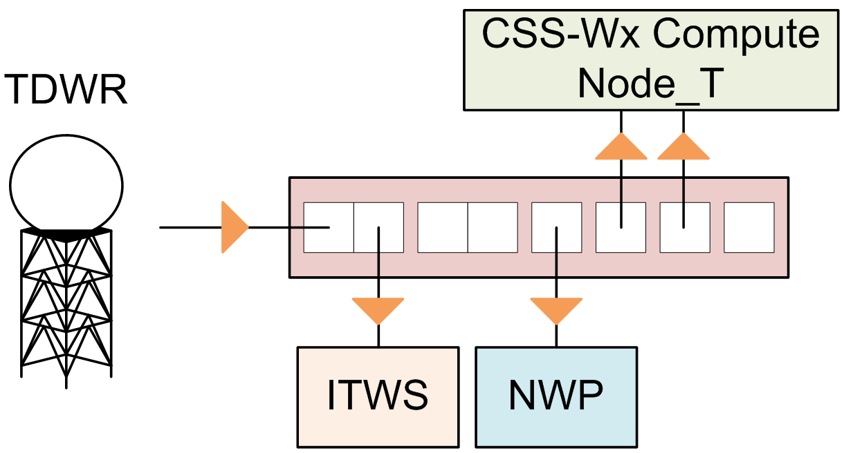
CSS-Wx Terminal Site Hardware (Cont.)
TDWR Receiver
Hardware: SINGLEstream Dual Link Aggregation TAP (SS- 2210BT-BT/SFP-S)
Quantity: Up to 7 (1 per TDWR + hot spare)

Slide 42
CSS-Wx TDWR Communications
TDWR
  Broadcast UDP
  Unidirectional
Network Tap
  Receives data from source
  Duplicates data across multiple ports
  Send data to:
    ITWS
    NWP
    CSS-Wx Terminal Compute Nodes
    Per IRD, Network Tap is point of demarcation for all connected programs

Slide 43
NWP Terminal Site Block Diagram
Preliminary Design

Slide 44
NWP Terminal Rack Layout
40 | Router FTI Interface 1
39 | Router FTI Interface 2
38
37 | Radar Interface
36
35
34
33
32
31
30
29
28
27
26
25
24
23
22
21 | Maint Laptop
20
19
18
17
16
15
14
13
12
11
10
9
8
7
6 | Server 2
5 | Server 1
4
3
2
1
Rack | Preliminary Design Terminal Site Rack
Configuration | 30 Inch Rack Depth
Equipment Weight lbs | 117
Power Max KW | 1.0
Spare U | 34
Total Core Count | 8
Preliminary Design:
2 Hot Failover Servers
  Single socket configuration
  Clocked at 3.3GHz
  Single threaded response time significantly faster than Domain
16 serial ports for ASR weather channel
Standard 30 inch rack
Empty
Laptop
Switch/Serial
Hot Failover/Product Generator Server

Slide 45
Dedicated AWD Site Block Diagram
(Preliminary Design)

Slide 46
Summary
CSS-Wx and NWP are being developed by Harris and Raytheon, respectively
  Achieved NWP Preliminary Design Review (PDR) in May 2016
  Achieved CSS-Wx Critical Design Review (CDR) in June 2016
CSS-Wx and NWP will provide improvements over legacy weather systems
AJM-333 coordinating site surveys, site preparation and installations
  Activities for CSS-Wx and NWP programs may occur at different time

